Slide 1
Software/Hardware Co-Design to Improve Productivity, Portability, and Performance of Loop-Task Parallel Applications
Ji Yun Kim
Computer Systems Laboratory
Cornell University
08/31/2016
Notes:
I’d like to start with a little interactive survey. I know there’s a lot of very experienced programmers here in the room today, and I’m curious to know how most of you start development on a brand new application.
Let’s say this is an emerging application that doesn’t have any existing codebase we can use as a baseline.
FPGA? MIC? GPGPU? Even before that, would you want to test for functionality and play around with the algorithm?
Most people would probably start from what they have readily available. The Intel processor in my laptop, for example.
Once we have a single-threaded implementation, what would you do next?
Any other favorite parallel programming frameworks people like? What do you like about TBB or OpenCL?
Let’s say we have an optimized CMP implementation, but unfortunately the performance is still not good enough, what would you do next?

Slide 2
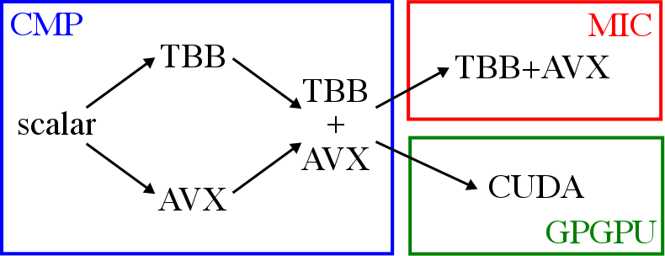
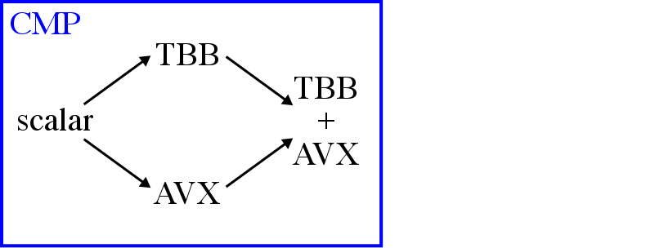
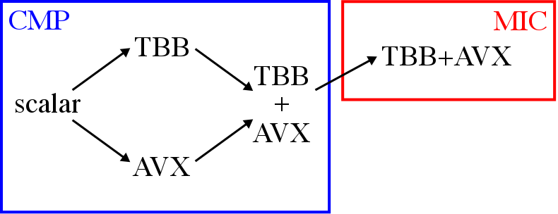
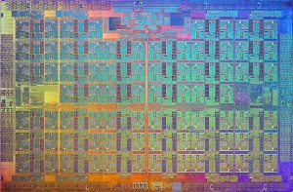
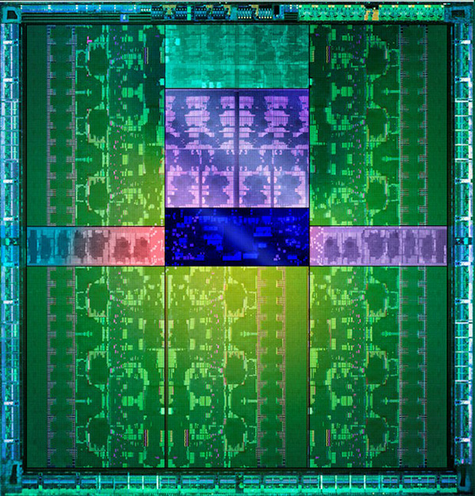
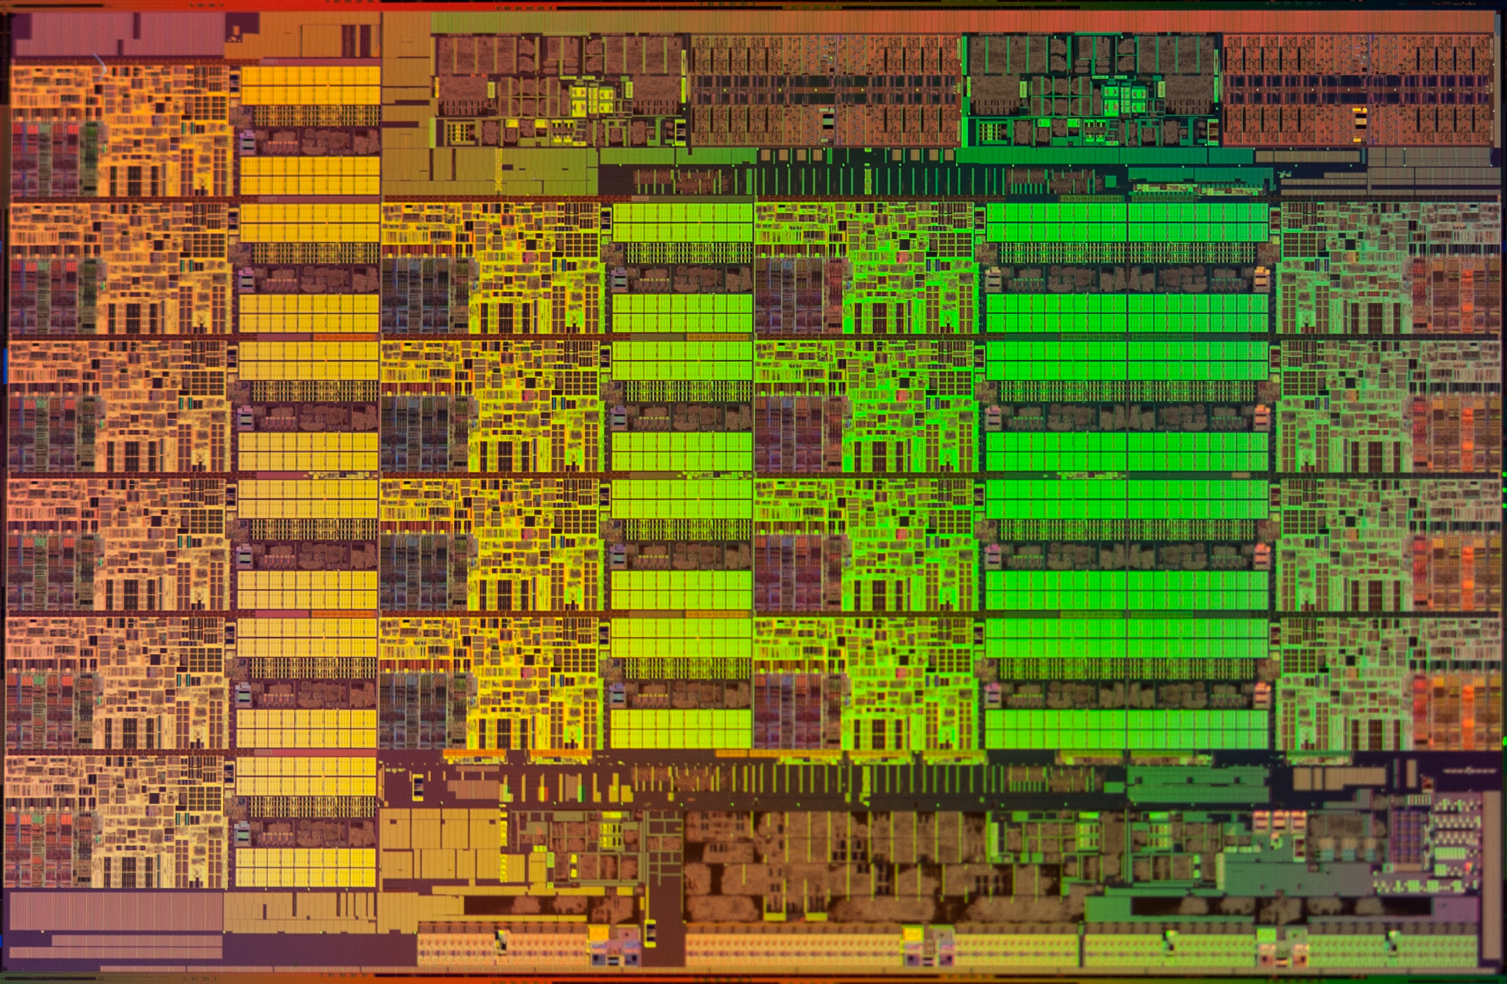
Example Application Development Flow
NVIDIA Tesla K20
Productivity
How easy is it to implement and optimize applications?
Portability
How easy is it to port applications across platforms?
Performance
How easy is it to achieve speedups for wide range of applications?
Intel Xeon E5 2600
Intel Xeon Phi 5110P
Notes:
I'd like to start by motivating the need for productivity, portability, and performance (otherwise known as the 3P's) in modern application development. I'd like to do this by walking through an example development process for an application with a high-performance target.
Usually development starts on a chip-multiprocessor (or CMP) like the Intel Xeon shown here. CMPs these days can have 4--16 superscalar OOO cores with packed-SIMD that can exploit data parallelism.
Personally, I like to start with a single-threaded scalar implementation to test for functionality.
For higher performance, one option is to vectorize the code using vector extensions like SSE or AVX. The preferred way of doing this is using the auto-vec feature in compilers, but if any of you have experience with vectorizing code, you'll know that it is rarely as simply as annotating... in fact, several specific optimizations are required to get the compiler to successfully...
Another option is to multi-thread the code using parallel programming frameworks such as Intel TBB. Of course, parallel programming has its own set of challenges and optimizations that can be very different from those used for vectorization.
We could also add vectorization on top of multi-threading to extract as much performance out of the CMP as possible. Unfortunately this is not always as simple as it might seem. The challenge stems from the different abstractions used by multi-threading and vectorization that can interfere with each other leading to performance degradation in some cases.
If the performance on the CMP is not enough, we can port the application to an accelerator like the Intel MIC. An example of this is Intel Xeon Phi... MICs can have up to 60 lightweight IO cores with wider packed-SIMD units. Porting the app to the MIC might require a different SW framework, but even if we can use the same framework, as in this example, there is a non-trivial amount of retuning and target-specific optimizations required to extract the most performance out of the HW.
Another popular accelerator is GPGPUs like NVIDIA Tesla. GPGPUs have... GPGPUs often require a different SW framework, like CUDA, that have an offload-based programming model which is very different than the programming models on the CMP or MIC.
Note that both the MIC and the GPGPU are best suited for accelerating applications with regular, structured control flow and memory access patterns.
Of course this is just one example of an application development flow, but I think many of you will agree with me that there are a lot of platforms available to the modern programmer. And by platform I mean a SW framework coupled with one or more HW architectures.
And I hope I have highlighted the importance of the 3Ps in application development: Productivity...
One example is the Intel Many Integrated Core architecture, like the Xeon Phi (aka Knight’s Landing). MICs have up to 60 lightweight cores with very wide packed-SIMD units, which means vectorization is even more important than on CMPs. Depending on the programming frameworks we used on the CMP, we might need to switch to a framework supported by the MIC. But even if we can use the same framework, there is a non-trivial amount of retuning necessary to extract the most performance out of the accelerator. (different SIMD width, changing grain size or thread count to maximize load balancing) This can get even more complicated if we decide to use an offload model instead of a native model.
Another popular accelerator is the GPGPU, short for general-purpose graphics processing unit, like the NVIDIA Tesla series. GPGPUs have dozens of SIMT engines that execute threads in lock-step. The programming framework for GPGPUs is very different from either CMPs or MICs, some common examples include CUDA or OpenCL. GPGPUs are nice since they use a common abstraction for exploiting inter- and intra-core parallelism, but the tradeoff is that they _require_ an offload programming model which makes it more challenging to port a CMP implementation.
Both MICs and GPGPUs are really designed for applications with data parallelism or task parallelism with regular control-flow and memory-access patterns.
I think most of you will agree that the modern programmer has a lot of options in terms of available platforms: I am defining platforms in this work as a combination of a software framework and one or more hardware architectures.
And I hope I have highlighted the importance of productivity, portability, and performance (or the so-called 3P’s) in modern application development flows. <Define the 3P’s>. Performance is important, but it is only as good as the productivity/portability that allows the programmer to achieve that performance.

Slide 3


Existing Approaches to 3P Platforms
Virtual ISAs
e.g.) AMD HSA, OpenCL, C++AMP
Domain-Specific Languages (DSL)
e.g.) Halide, OptiML, Delite
SW-centric approaches for existing HW architectures
J. Ragan-Kelley, et al. Halide: A Language and Compiler for Optimizing Parallelism, Locality, and Re- computation in Image Processing Pipelines. PLDI 2013.
Heterogeneous System Architecture: A Technical Review. AMD White Paper 2012.
Notes:
I am not the first to address the challenge of achieving a 3P platform.
For example, Virtual ISAs, like those used in AMD HSA, are software translation layers that allow the programmer to use a single software framework (OpenCL or C++ AMP) to target multiple architectures. Although in theory this would mean a single implementation of an application could be used for any target, in practice, a non-trivial amount of target-specific optimizations are required to achieve high performance on a given architecture.
DSLs, like Halide, are software frameworks specialized for a narrower application domain (like image processing), that leverages domain-specific abstractions to improve the 3P’s. However, this comes at the cost of generality at the application level, even though DSLs can target a variety of different architectures.
Importantly, both of these examples are software-centric approaches that are designed to be layered over a given set of hardware architectures. These approaches do a great job of unifying abstractions for exploiting parallelism across cores and within a core, but rely on software translation to map these abstractions to hardware, which can limit performance and efficiency.

Slide 4
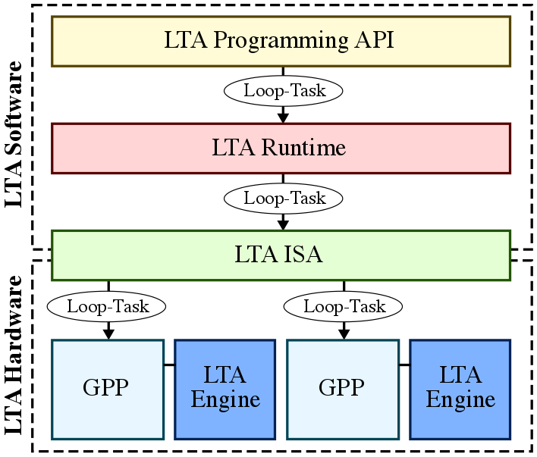
Loop-Task Accelerator (LTA) Vision
Notes:
However, what if we could redesign the SW *and* the HW to push the same abstraction in SW down the computing stack to the HW? Could we achieve the high productivity and portability without sacrificing performance or efficiency for a wide range of applications?
Today I would like to explore this question with my proposal for a SW/HW codesign approach for achieving a 3P platform, called the loop-task accelerator (or LTA) platform.
The overall vision of the LTA platform is shown here. The goal is to efficiently exploit loop-task parallelism, a form of task parallelism exposed by the popular parallel_for construct, both across cores and within a core. This is done by exposing loop-tasks as the common abstraction at the programming API, runtime, ISA, and microarchitectural levels.

Slide 5
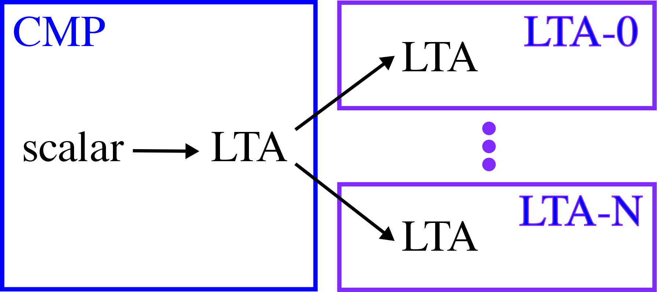
LTA Application Development Flow
Single target-agnostic implementation
Less reliance on target-specific optimizations
High performance on regular and irregular applications
Notes:
Here is what the application development flow might look like using the LTA platform.
We would still start with a scalar implementation before using the LTA parallel programming framework to write a multi-threaded implementation on the CMP.
Furthermore, we can write and compile this implementation once and run the application on a variety of LTA engines that can accelerate both regular and irregular applications.
Pushing the common abstraction down to the physical ISA level facilitates efficient fine-grain load balancing in homogeneous or heterogeneous systems.

Slide 6
Presentation Overview
App Dev Case Study
LTA Software
LTA Hardware
LTA Evaluation
Related Works
Conclusions
Notes:
Here is the outline for the rest of the presentation.
Next I would like to present a case study of my personal experience traversing the example application development flow shown at the beginning of the talk to crystallize the goals of the LTA platform.
Then I would like to describe the SW and HW components of the LTA platform and provide a detailed evaluation of the LTA platform with respect to the 3Ps, before wrapping up with some related work and conclusions.

Slide 7
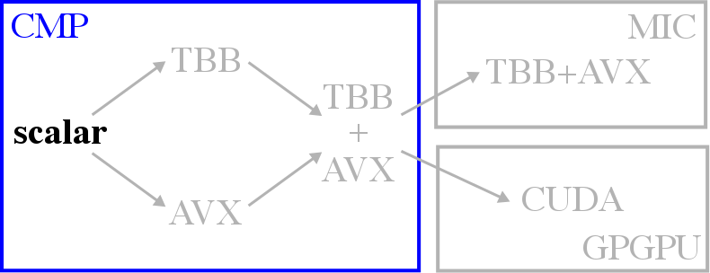
void rgb2cmyk_cmp_scalar(int size,
RgbPixel** src, CmykPixel** dst) {
for (int i = 0; i < size; i++) {
for (int j = 0; j < size; j++) {
// Calculate intermediate values
byte tmp_c = 255 - src[i][j].r;
byte tmp_m = 255 - src[i][j].g;
byte tmp_y = 255 - src[i][j].b;
byte tmp_k = std::min(
tmp_c, tmp_m, tmp_y);
// Store results into output array
dst[i][j].k = tmp_k;
dst[i][j].c = tmp_c - tmp_k;
dst[i][j].m = tmp_m - tmp_k;
dst[i][j].y = tmp_y - tmp_k;
}
}
}
Notes:
For this case study, I would like to focus on the development process for rgb2cmyk, which is an application kernel for color conversion that takes a matrix of RgbPixels as input and generates the corresponding matrix of CmykPixels as the output.
The code shown here is the single-threaded scalar implementation of rgb2cmyk. The input and output are 2D arrays and this double for loop traverses each element in the array, reading the color components of each input pixel, doing some computation on it, and writing the converted color components to the output pixel.

Slide 8
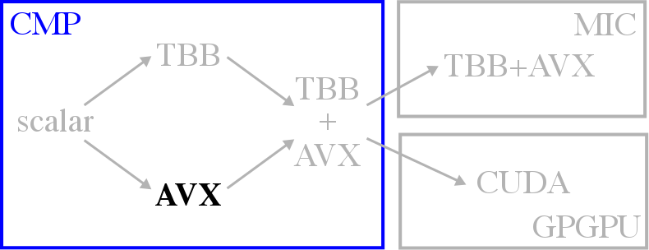
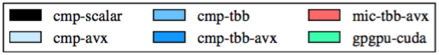
void rgb2cmyk_cmp_avx(int size,
RgbPixel** src, CmykPixel** dst) {
// Pack data into aligned arrays
byte* __restrict__ aligned_r =
(byte*)memalign(NBYTES, SIMD_WIDTH);
...
pack_aligned(src,
aligned_r, aligned_g, aligned_b);
__assume_aligned(aligned_r, SIMD_WIDTH);
...
// Vectorize within a row
for (int i = 0; i < size; i++) {
#pragma simd vlen(SIMD_WIDTH)
for (int j = 0; j < alsize; j++) {
...
byte tmp_c = 255 – aligned_r[i][j];
...
}
}}
byte min_nobranch(byte a, byte b) {
byte diff = a – b;
byte a_min = diff >> (sizeof(byte) – 1);
return b + a_min * diff;
}
Notes:
Next let's take a look at some of the optimizations required to successfully auto-vectorize this code.
I going to be showing a lot of code snippets, but don't worry because I'm just using these examples to highlight the challenges in productivity and portability at different points in the development flow, so it's not important to understand every detail of the application.
In this example, we are vectorizing computation across elements within a row. As mentioned before, simply annotating loops with pragmas as shown here is not enough.
One of the most important optimizations is ensuring memory accesses are aligned and unit-stride so that the compiler can generate efficient vector loads/stores. This means allocating memory aligned to the SIMD-width and converting the input from an array of structs to a struct of arrays before copying the data to the aligned memory. We also need to ensure that each row is padded to the SIMD-width to ensure accesses to the next row is aligned as well.
Another important optimization is eliminating as much control flow as possible since SIMD data needs to be processed in lock-step. In this example, the STL minimum function has been replaced with a custom min_nobranch function that computes the minimum using arithmetic and bit shifting.
The plot here on the left is showing the speedups of the optimized, vectorized implementation of rgb2cmyk as well as 6 other application kernels normalized to the scalar implementation. Notice that vectorization only benefits applications with regular control flow and memory access patterns, whereas more irregular applications see no or marginal benefit.
Note that if control flow is unavoidable you might have to resort to using a more naive algorithm to enable vectorization as is the case in dct8x8m.
Successful auto-vectorization frequently requires a separate set of optimizations. Ensuring aligned memory accesses and eliminating control flow are the most important.
The strategy here is to vectorize computation across multiple elements within a row, thus we annotate the innermost loop with a pragma.
If we look at the performance results, we see that only the application kernels with regular control and memory access patterns show any meaningful benefit. Even across regular application kernels, the speedup depends on several factors like memory-boundness, and the actual degree of regularity.
In the case of mriq, converting branches into arithmetic for the sin/cos functions actually create more work (less computationally efficient) which can offset the speedup to an extent.
Since AVX2 supports 256b-wide packed-SIMD units, the ideal speedup would be 8 if the application is perfectly compute-bound. Obviously this is rarely the case, but sgemm and rgb2cmyk do approach this upper bound.

Slide 9
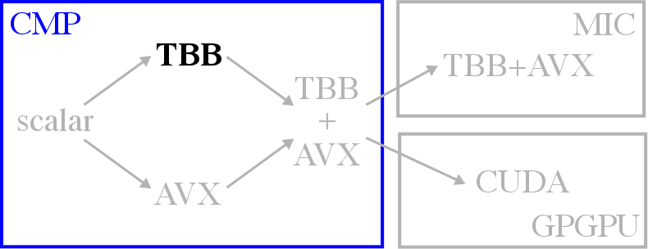
void rgb2cmyk_cmp_tbb(int size,
RgbPixel** src, CmykPixel** dst) {
// Flatten matrices
flatten(fsrc, src);
// Parallelize across elements (flat)
parallel_for (
range(0, size*size, TASK_SIZE),
[&] (range r) {
for (int i = r.begin();
i < r.end(); i++) {
// Calculate intermediate values
byte tmp_c = 255 - fsrc[i].r;
byte tmp_m = 255 - fsrc[i].g;
byte tmp_y = 255 - fsrc[i].b;
byte tmp_k = std::min(
tmp_c, tmp_m, tmp_y);
// Store results into output array
fdst[i].k = tmp_k;
fdst[i].c = tmp_c - tmp_k;
fdst[i].m = tmp_m - tmp_k;
fdst[i].y = tmp_y - tmp_k;
}
});
}
Notes:
Next is the multi-threaded implementation without vectorization.
Although there are a lot of options for parallel programming frameworks like OpenMP or Cilk, in this study I am using Intel TBB.
TBB is good for several reasons: it offers a productive task-based programming model, it has a library-based implementation (making it more portable, no compiler modifications required), and supports dynamic work-stealing.
There are multiple ways we can parallelize computation. For instance, we could parallelize computation across the rows of the output matrix, but I have found it is very useful to actually flatten matrices into 1D arrays to generate finer-grain tasks which improve load balancing.
Here the TBB parallel_for construct is used to iterate across all elements in the input matrix and the range object is used to specify the start and end indices for a given task. This TASK_SIZE variable is specify the minimum task size to the runtime's task partitioner, and the optimal task size can vary across different applications.
This next bar in the plot is showing the speedups of the multi-threaded implementation normalized to the scalar baseline for each benchmark. We see speedups for both regular and irregular applications by exploiting parallelism across cores.
There are several ways we can parallelize computation, but in this example, I am flattening the input matrix and parallelizing computation across individual elements. Another way to do this would be to parallelize computation across rows, but I found that in many cases having finer-grain tasks improves performance by increasing opportunities for load balancing. For example, in this example, there was roughly a 14% improvement in performance by flattening the matrix.
Notice the TASK_SIZE variable here. This is called the grain size in TBB and is used to hint to the runtime’s task partitioner what the final task size should be. Let me emphasize that this is a hint, and doesn’t guarantee exact task sizes due to recursive decomposition algorithm used by the runtime.
In terms or performance, we see reasonable speedups for both regular and irregular applications. Remember that this is multi-threading without vectorization. In the case of bfs-nd, the lower speedup is actually due to synchronization overheads from fine-grain locking (using AMOs).
Without going into too much detail about work-stealing, there have been a large body of work on the efficiency of pull-based models vs. push-based models, which allows for better load balancing.

Slide 10
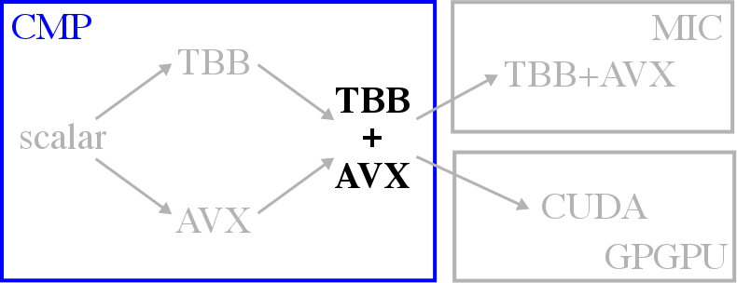
void rgb2cmyk_cmp_tbb_avx(int size,
RgbPixel** src, CmykPixel** dst) {
// Pack data into aligned arrays
...
// Parallelize across rows
parallel_for (
range(0, size, TASK_SIZE),
[&] (range r) {
for (int i = r.begin();
i < r.end(); i++) {
// Vectorize within a row
#pragma simd vlen(SIMD_WIDTH)
for (int j = 0; j < alsize; j++) {
...
byte tmp_y = 255 – aligned_b[i][j];
byte tmp_k = min_nobranch(
tmp_c, tmp_m, tmp_y);
...
}
}
});
}
Notes:
Now, let's look at an implementation that combines multi-threading and vectorization.
Ideally, this implementation should extract the most performance out of the CMP by utilizing more resources.
However, there are two reasons why this might not always be the case.
First, task partitioning with TBB can prevent auto-vectorization by generating tasks with no guarantee of aligned memory accesses.
Second, eliminating control flow to enable auto-vectorization can reduce opportunities for load balancing with TBB.
Both cases arise from the fact that the abstractions for multi-threading and vectorization not necessarily aware of each other.
Because of this, the programmer must decide to sacrifice some load balancing or vectorization in many situations.
The speedups for the combined implementation show that in some cases we can achieve multiplicative effects in perf as in sgemm, but in several other cases, the combined implementation results in slowdowns.
The point I hope is becoming clear is that it's difficult to port an application even within a CMP and it's also difficult to extract the most performance out of the HW resources.
However, this is not always the case, as we can see in dct8x8m, mriq, and rgb2cmyk. Irregular application kernels which didn’t see any benefit from vectorization before expectedly do not show any change by adding AVX to TBB.
In general, this behavior can be attributed to two reasons. First, task partitioning with TBB limits auto-vectorization…. Because of this, it may be desirable to parallelize computation across coarser-grain rows rather than flattening the matrix (which we saw yielded better performance). Second, eliminating control flow to enable AVX can limit load balancing with TBB… Because of this, the work efficiency of the combined implementation might be worse than a purely TBB implementation. For example, in mriq, profiling the TBB implementation with and without this optimization results in a 75% increase in the number of dynamic instructions.
In some cases, the closure of the lambda/functor used by TBB’s parallel_for can actually confuse the compiler about the alignment of arrays that were explicitly aligned, which can generate much less efficient unaligned loads/stores or gathers/scatters.

Slide 11
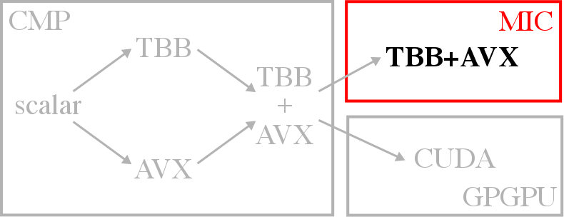
void rgb2cmyk_mic_tbb_avx(int size,
RgbPixel** src, CmykPixel** dst) {
// Pack data into aligned arrays
...
// Parallelize across chunks
parallel_for (
range(0, size*NCHUNKS, TASK_SIZE),
[&] (range r) {
for (int ri = r.begin();
ri < r.end(); ri++) {
// Calculate chunk offsets
int i = ri / NCHUNKS;
int i_off = ri % NCHUNKS;
int j_s = i_off * CHUNK_SIZE;
int j_e = j_s + CHUNK_SIZE;
// Vectorize within a chunk
#pragma simd vlen(SIMD_WIDTH)
for (int j = j_s; j < j_e; j++) {
...
byte tmp_y = 255 – aligned_b[i][j];
byte tmp_k = min_nobranch(
tmp_c, tmp_m, tmp_y);
...
}
}
});
}
Notes:
The MIC implementation shown here uses the same SW framework combining TBB and AVX as the CMP.
Notice the code has become even more complicated!
Because there are so many cores on the MIC and lot of the MIC's performance is locked in the wider packed-SIMD units, it's actually more important to leverage both multi-threading and vectorization here.
Besides the fact that the TASK_SIZE and the number of threads on the MIC need to be retuned for the MIC, additional optimizations may be necessary to generate finer grain tasks to improve load balancing across 60 cores, for instance by breaking up each row into smaller aligned chunks.
The speedups of the MIC implementation are shown with the newest bars. In general, regular applications that can better leverage the SIMD units see the most significant improvements, but irregular applications see benefit from the increased number of cores as well. Unfortunately, the speedups are not always proportional to the resources available on the HW.
MICs can be programmed in offload mode or native mode. There are tradeoffs with each approach but in this study we focus on the more productive native model.
Much of the performance of the MIC is locked in the packed-SIMD units so it becomes even more important to enable vectorization as much as possible.
In addition, load balancing also becomes increasingly important when there are 60+ cores. As such, we might need to restructure the code to enable both finer-grain tasks as well as vectorization. One way to do this is to split rows into SIMD-width-aligned chunks and parallelize computation across these chunks. We need to guarantee that the chunks are multiples of the SIMD-width so the compiler can assume every task accesses SIMD-width-aligned memory. For example, not doing this additional chunking on the MIC can result in performance worse than the CMP (3.5x slowdown comparing with and without chunking).
Other parameters also need to be retuned for the MIC (different from the CMP): the grain size will be different as well as the number of threads. Each MIC core supports 4 physical threads (not SMT), but the maximum number of threads does not always yield the highest performance. Optimal number of threads are usually 3—4 threads per core.
We see performance for both regular and irregular, although the most significant improvements are for those that can utilize the packed-SIMD units efficiently. Otherwise, the sheer increase in the number of cores can still benefit more irregular applications.

Slide 12
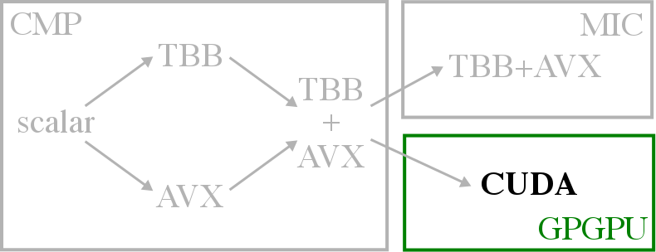
__global__ void rgb2cmyk_kernel(int size,
byte* src_r, ..., byte* dst_c, ...) {
// Calculate index
int i = blkIdx.y * BSIZE + thdIdx.y;
int j = blkIdx.x * BSIZE + thdIdx.x;
if (i >= size || j >= size) return;
...
}
void rgb2cmyk_gpgpu_cuda(int size,
RgbPixel** src, CmykPixel** dst) {
// Allocate device memory, copy data
byte* src_r, d_src_r;
...
unpack_arrays(src,
src_r, src_g, src_b);
cudaMalloc((void**)&d_src_r, NBYTES);
cudaMemcpy(d_src_r, src_r, NBYTES, HtoD);
...
// Invoke kernel on device
rgb2cmyk_kernel<<<grid,block>>>(
size, d_src_r, ..., d_dst_c, ...);
// Copy results to output
cudaMemcpy(dst_c, d_dst_c, NBYTES, DtoH);
...
pack_arrays(dst,
dst_c, dst_m, dst_y, dst_k);
}
Notes:
Finally, here is the GPGPU implementation using CUDA. This implementation is very different from the other implementations we've seen so far because of the offload-based programming model.
This means that we need to manually allocate memory on the GPGPU and transfer data explicitly between the host and device. We also need to manually partition the work into blocks and grids, and ensure the arguments to the kernel are not arrays of structs.
Although a regular application is shown here, the real challenge in productivity and portability for GPGPUs is for irregular applications, which are notoriously difficult to efficiently map to GPGPUs.
As such, the results on the left show very high speedups for regular applications, but not resource-proportional performance with more irregular applications.
GPGPUs use an offload programming model (CUDA, OpenCL) which is vastly different from the other frameworks we’ve seen so far. Offload models generally require explicit memory allocation and transfer between the host and the device. Arguments need to be captured manually and there are restrictions on the types of data structures that can be used as arguments. Block/grid sizes need to be set manually and GPGPUs do not support work-stealing (they use a hardware work scheduler). There are also limitations on STL data types that can be used inside the kernel (although libraries like Thrust help this issue).
Even when using OpenCL, there are many non-trivial differences between the CMP-specific and GPGPU-specific optimizations. Need to know microarchitectural details… efficient use of texture/shared memory.
Although a regular application is shown as an example, the real challenge in terms of the 3P’s on GPGPUs is with mapping irregular applications, especially those with inter-thread communication. Barriers can lead to deadlock and AMOs for fine-grain locking across thousands of CUDA threads can significantly hamper performance.

Slide 13
Key Takeaways
Most platforms have low productivity (except CMP-TBB)
Low portability even using the same SW framework
Inter-core * intra-core parallelism != multiplicative effect
Performance on irregular apps not resource-proportional
Productivity of TBB for all inter-/intra-core parallelism
Portability that allows single implementation on all targets
Better guarantee of high performance on regular/irregular
Notes:
Given all of this, I'd like to summarize the key observations into 4 takeaways:
...
Ideally, we would like...

Slide 14
Presentation Overview
App Dev Case Study
LTA Software
LTA Hardware
LTA Evaluation
Related Works
Conclusions
Notes:
The proposed LTA platform proposes to achieve these goals by using loop-tasks as a common parallel abstraction across SW and HW.
and pushing this abstraction from software down to the hardware.

Slide 15
Loop-Task Parallelism
Form of task parallelism exposed by parallel_for
Variability across loop iterations due to data-dependent branches
Encode loop-tasks as a four-tuple:
lta::parallel_for(0, size, [&](int i) {
if (src[i].cond0)
dst[i] = task0();
else if (src[i].cond1)
dst[i] = task1();
});
Notes:
So what exactly is loop-task parallelism? As mentioned before, loop-task parallelism is a form of task parallelism...
Loop-task parallelism captures the parallelism across loop iterations that may have significant variability due to data-dependent branches.
Some of you may be wondering why loop-task parallelism? One observation is that narrowing the scope of the parallel abstraction in SW allows us to more efficiently encode and relay information about exploitable parallelism to the HW. So the LTA platform focuses on a narrower form of task parallelism exposed by the popular and familiar parallel_for construct.
To this end, the LTA platform exposes loop-task parallelism by using so-called loop-tasks as the common parallel abstraction.
Loop tasks are encoded as a four-tuple consisting of the pointer to the loop function, the pointer to the arguments of the function, and the start and end indices of the loop iterations to which to apply the function.
Here is an example of a parallel_for using the LTA programming API. The loop function inside has some data-dependent branches that can change the nature of the computation, the pointer to this function is mapped to the first field in the loop task. The arguments captured by this lambda closure are mapped to the second field, and the start and end indices are mapped to the third and fourth fields.
One way we can do this is by narrowing the scope of the parallelism supported by the software. Instead of supporting the more generic task parallelism, I chose to focus on the a more specific form of task parallelism exposed by the popular and familiar parallel_for construct.
This is the parallelism of being able to execute loop iterations in parallel. Note that this captures a more traditional data parallelism when there is regular control flow and memory accesses across the loop iterations, but also captures what is closer to task parallelism when there is enough irregularity in control flow that each loop iteration can be considered a different task.
Why loop-task parallelism? One observation from looking at related work is that narrowing the scope of the parallel abstraction in SW allows us to more efficient encode this abstraction into a form HW can understand (see DSLs). Ideally, we would be able to encode all sorts of other parallel abstractions but that would complicate pushing this abstraction down the computing stack. So we choose loop-task parallelism since parallel_for constructs are popular and familiar. Of course, this is meant to be a first step towards a 3P platform using SW/HW codesign, so there is definitely room for others to explore how they can broaden the scope and maintain efficiency.

Slide 16
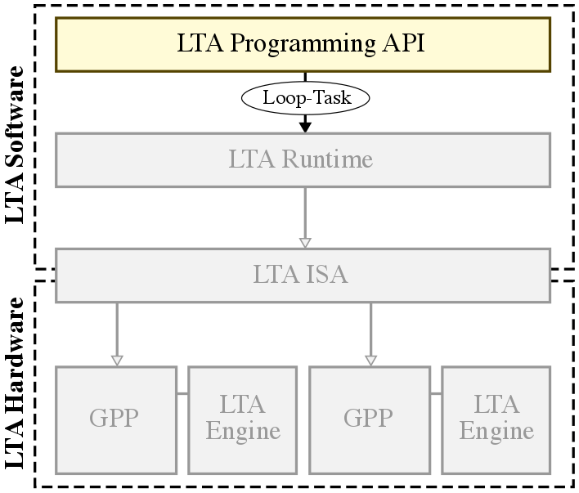
LTA Programming API
lta::parallel_for(0, size, [&](int i) {
if (src[i].cond0)
dst[i] = task0();
else if (src[i].cond1)
dst[i] = task1();
});
LTA_PARALLEL_FOR(0, size, (dst, src) ({
if (src[i].cond0)
dst[i] = task0();
else if (src[i].cond1)
dst[i] = task1();
}));
Notes:
We’ve seen how loop tasks are exposed in the LTA programming API using a lambda-based parallel_for. Unfortunately, the LTA cross-compiler does not support C++11 lambdas yet, so I use an alternate macro-based variant of the parallel_for shown here on the bottom which does the same thing. But both variants are sketched out as part of the LTA vision.
Now let’s look at how these loop-tasks are exposed in the LTA programming API.
The lambda-based parallel_for was also explored, but unfortunately our cross-compiler does not support C++11 lambdas yet, so in this work I focus on the macro-based variant.

Slide 17
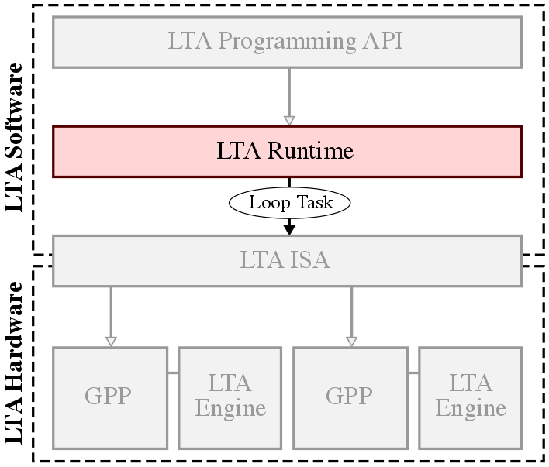
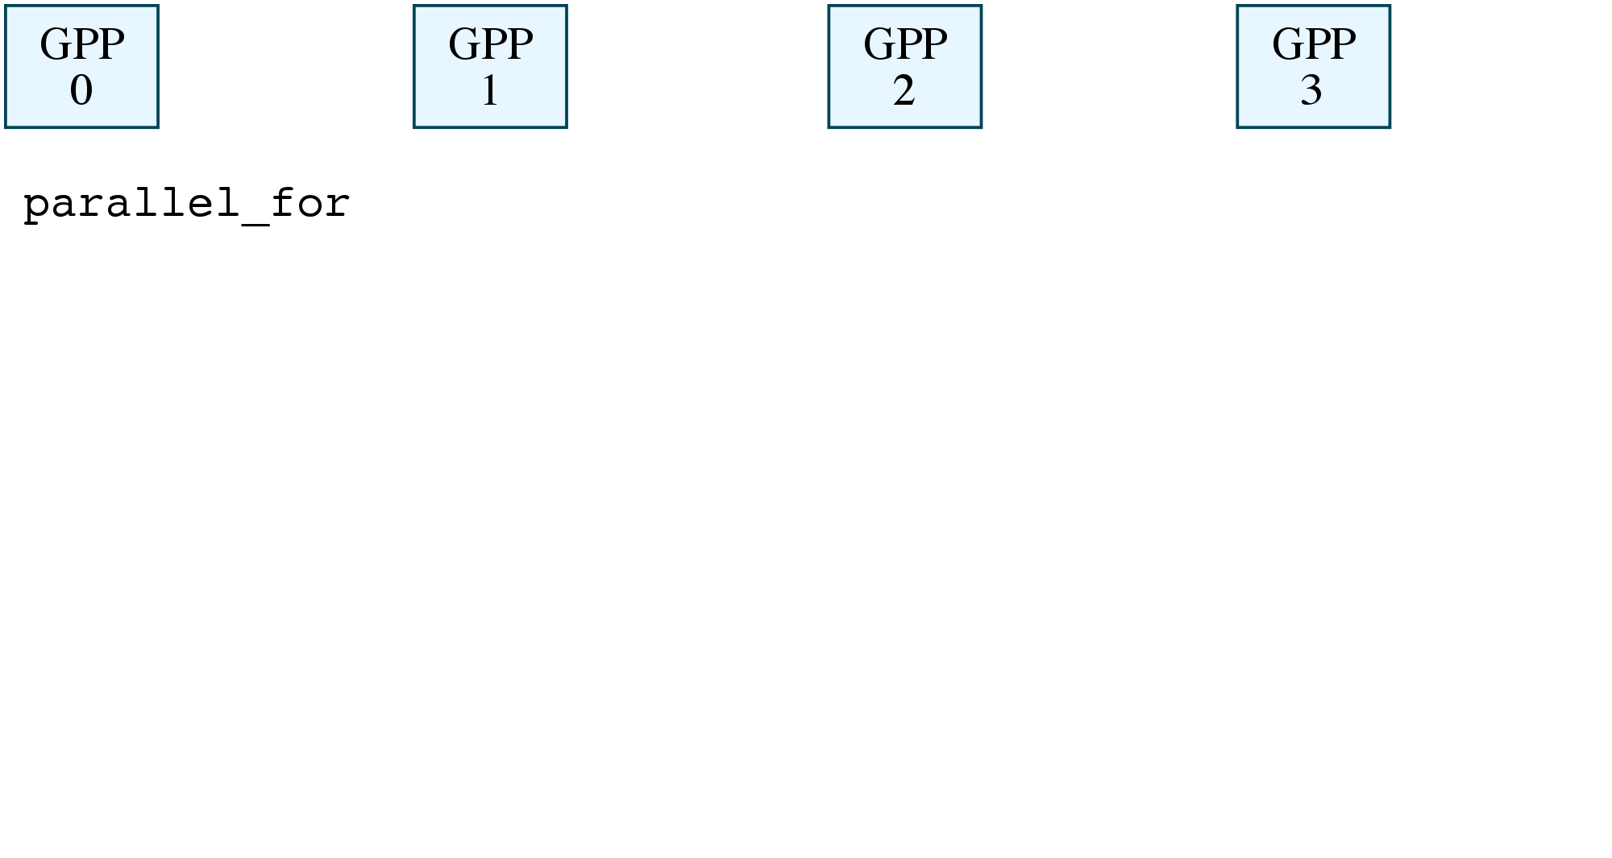
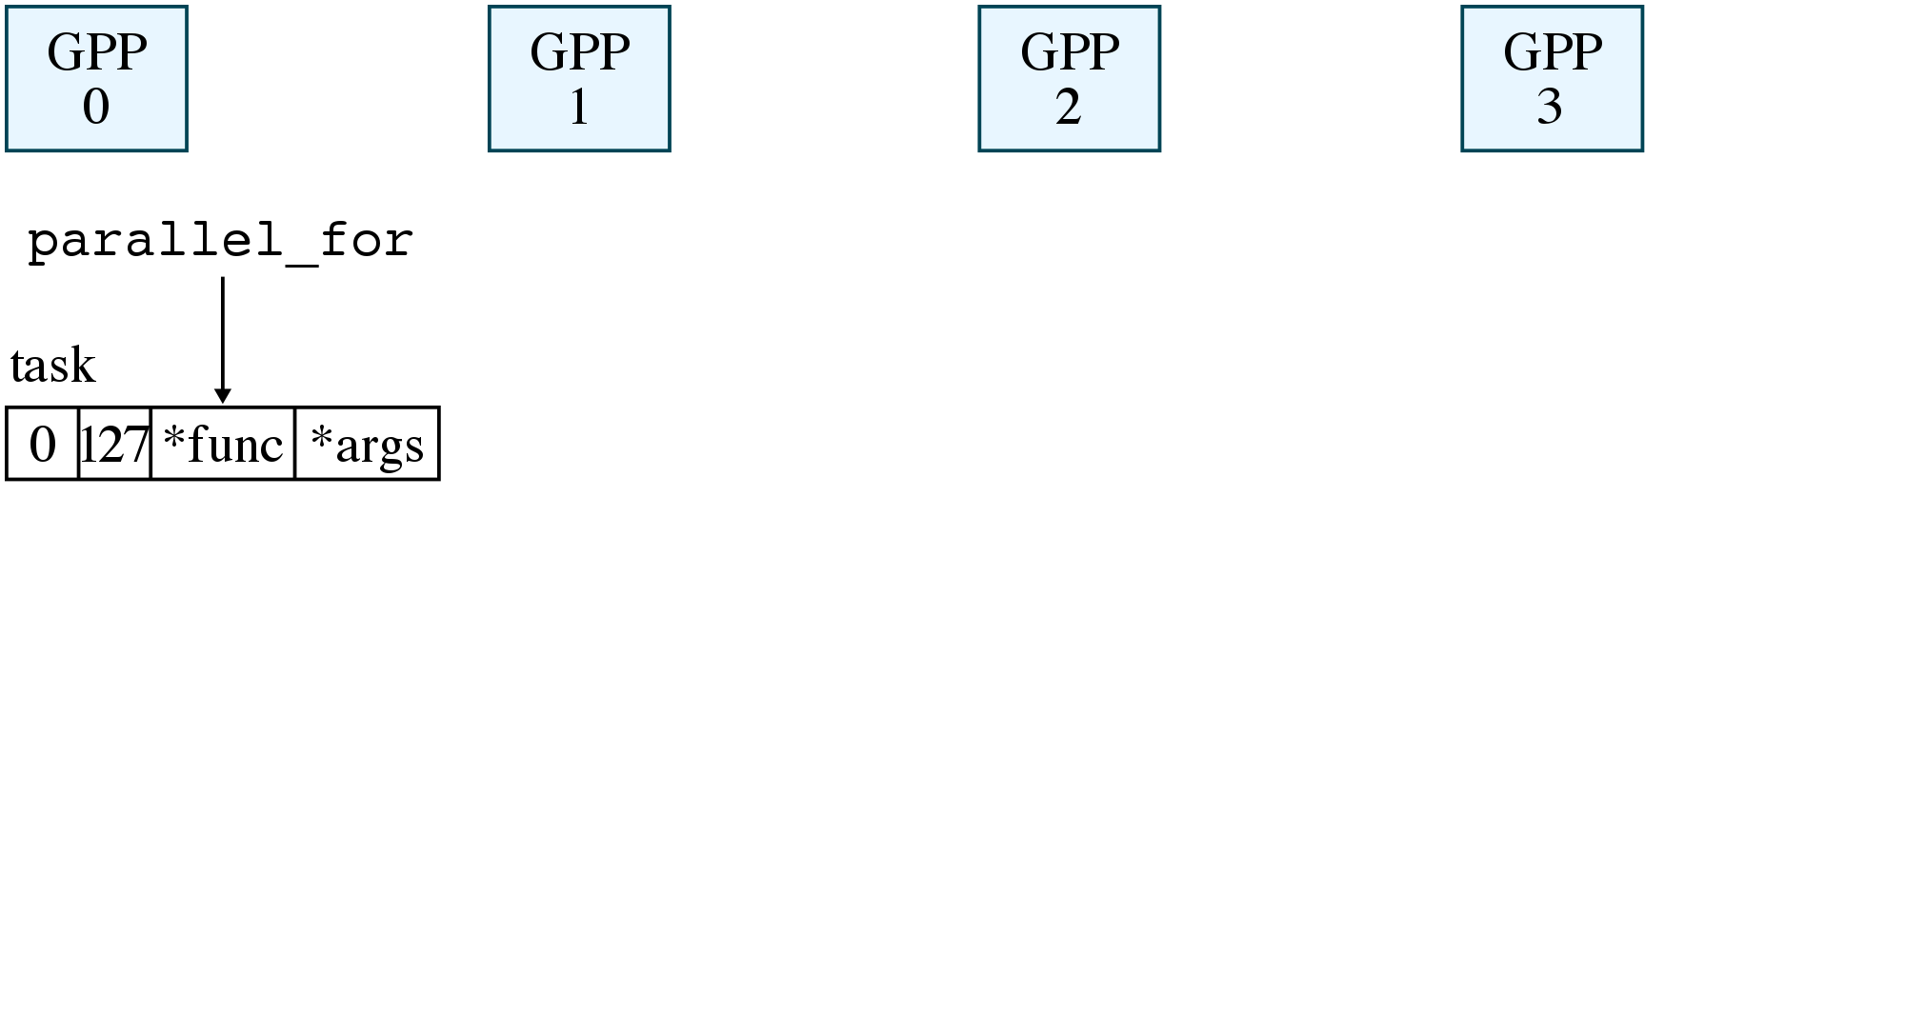
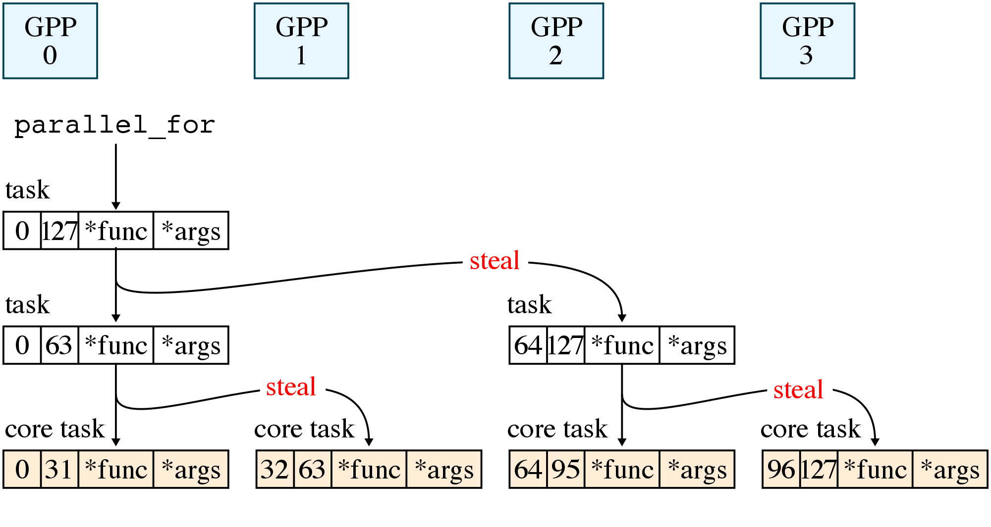
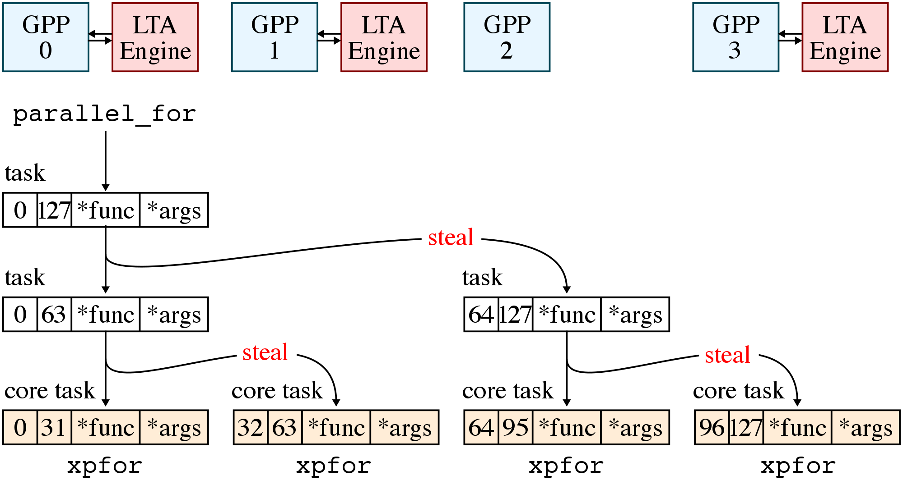

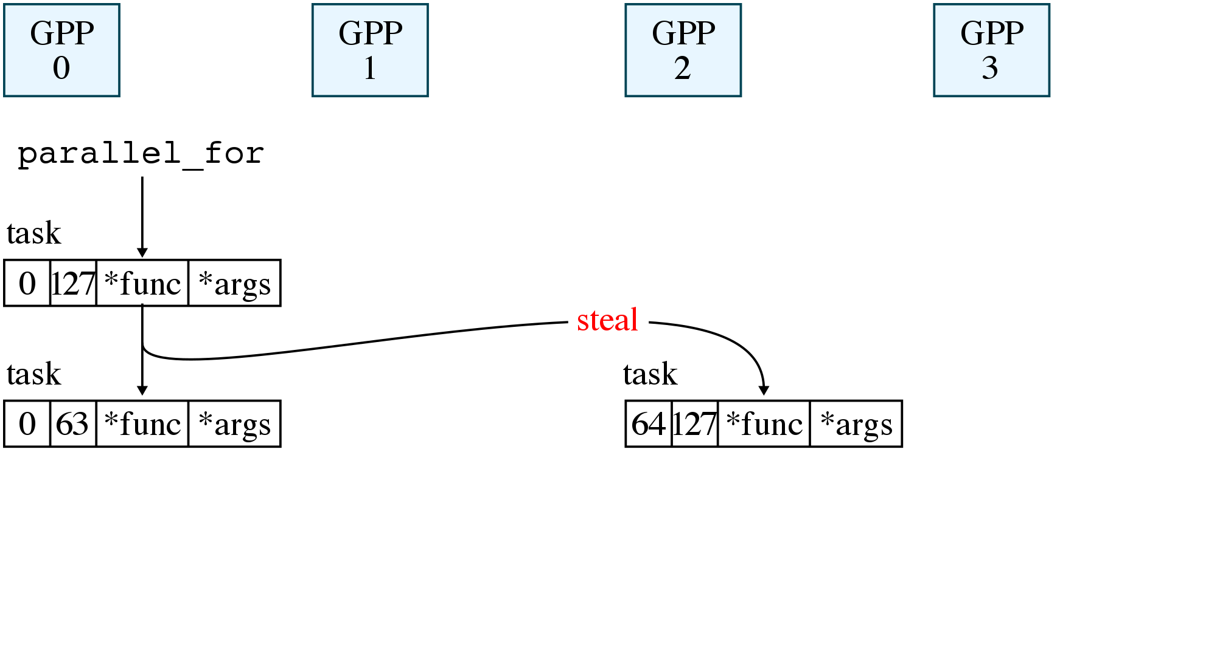
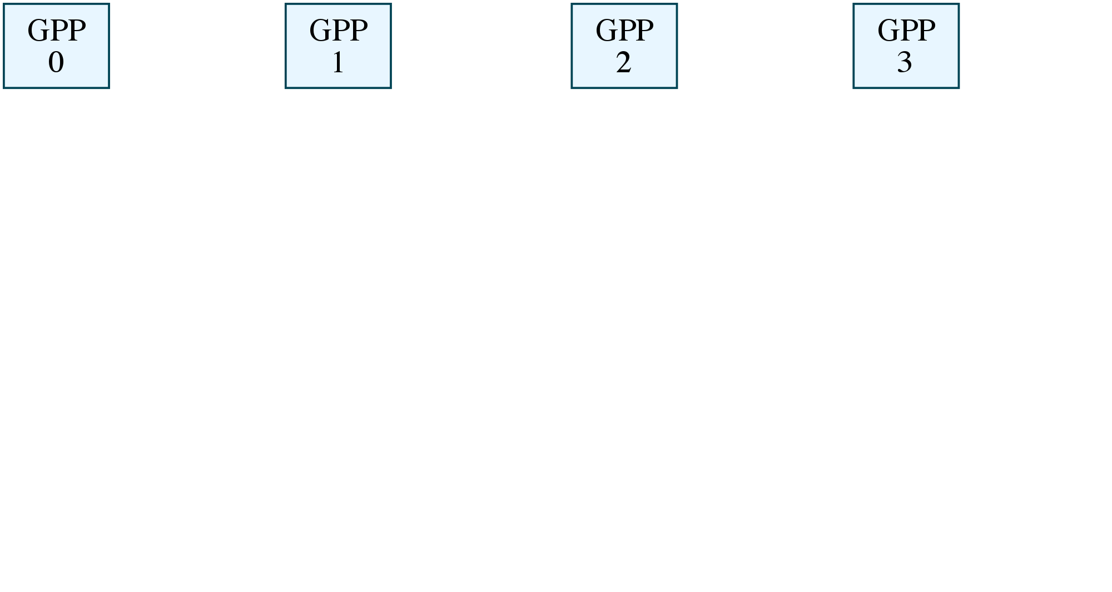
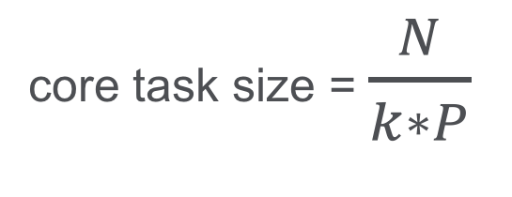
LTA Runtime
core task size = $\frac{N}{k∗P}$
Notes:
The LTA runtime is responsible for generating, partitioning, and distributing loop tasks exposed by the programming API.
Let’s take a look at an example of how the LTA runtime performs its duties on a four-core system.
The master core, GPP0, begins execution of the binary while the other cores spin on a work-stealing loop in the runtime. When GPP0 encounters a parallel_for, it generates the first loop task with the function pointer, the argument pointer, and the initial range of loop iterations.
GPP0 then partitions this loop task by splitting the range in half, generating 2 loop tasks with a smaller range. GPP2 can steal one of these loop tasks, then both GPP0 and GPP2 can continue this recursive decomposition, allowing other cores to steal loop tasks.
The runtime stops partitioning tasks when the range is less than or equal to the core task size, which is defined by this equation. Where N is the initial range of the first loop task, P is the number of cores in the system, and k is a scaling factor. The higher the k, the more finer grain tasks will be generated. A loop task at this point is called a core task and is the smallest unit of load balancing across cores.
Core tasks can be executed by using a special xpfor instruction. The xpfor instruction has the same semantics as a jalr and acts as an indirect function call on a GPP. More importantly, it also acts as a hint to the HW that it can use an LTA engine to accelerate core task execution, if there is one available.
Note that this allows the runtime to execute core tasks in the same way regardless of whether or not there is an LTA engine available on the GPP, helping to improve portability.
GPP0 partitions the root task into two loop tasks by splitting the range in half, before pushing these loop tasks into its task queue in memory…
The runtime stops partitioning once a core task size is reached, at which point the loop tasks are called core tasks.

Slide 18
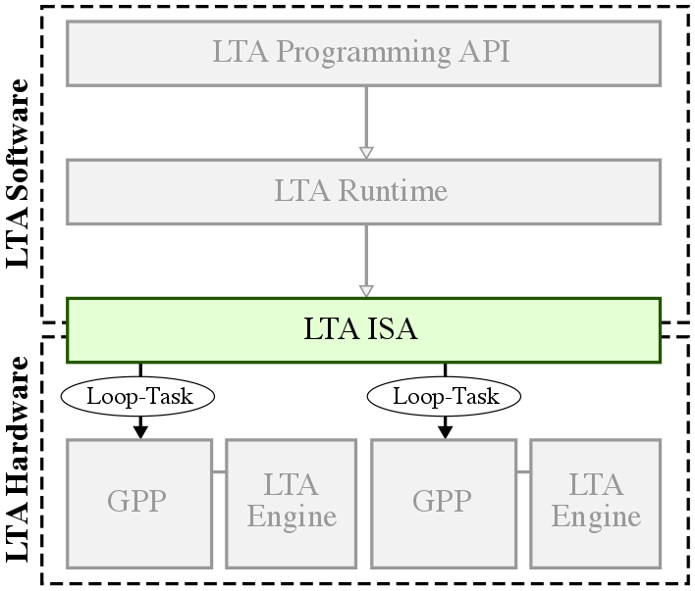
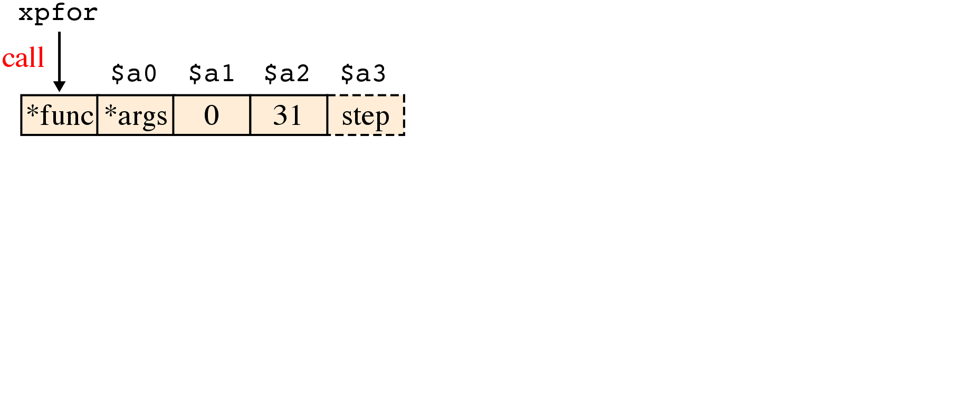
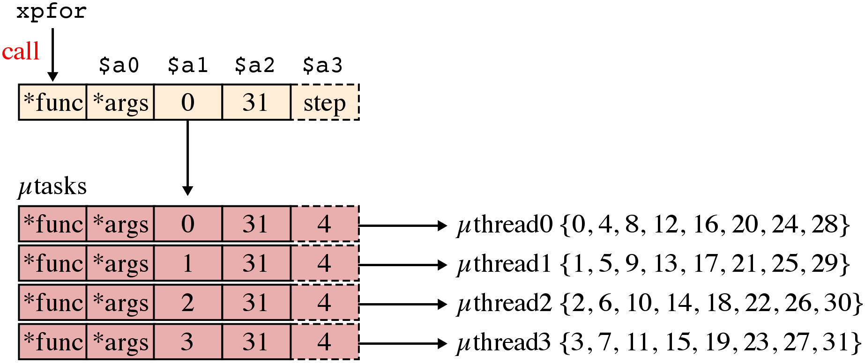
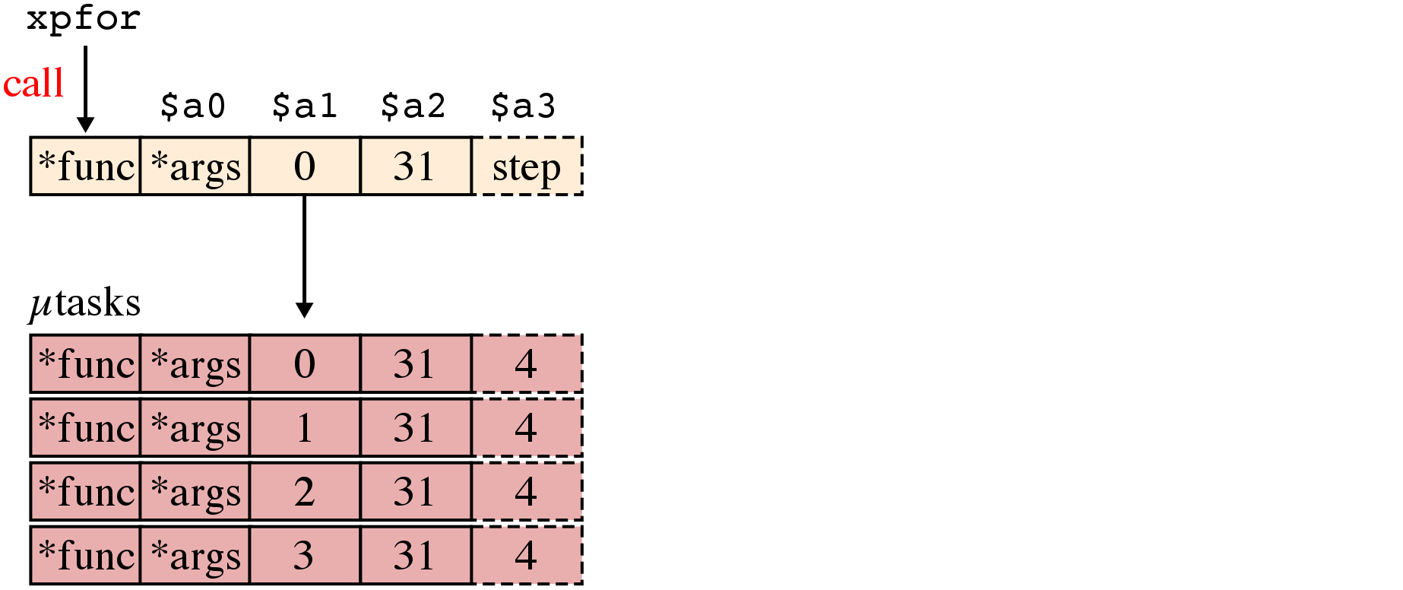
LTA ISA
void lta_function(
void* a, // $a0
int start, // $a1
int end, // $a2
int step=1 // $a3
) { ... }
xpfor has same semantics as jalr
Map µtasks to µthreads to accelerate execution
LTA runtime uses µthread-aware task partitioning
Notes:
Specifically, the calling convention of the xpfor instruction is crafted to mirror the arguments of the loop task function generated by the parallel_for macro we saw earlier.
Note that in addition to the function pointer, the argument pointer, and the start/end indices, thre is also an extra argument called the step value that is hidden from the SW programmer which can be used to specify the stride of the loop iterations corresponding to a loop task.
Furthermore, the HW is responsible for setting the architectural state with the appropriate values.
The xpfor instruction signals to the LTA engines that the core task can be accelerated. LTA engines accelerate core task execution by further partitioning core tasks into utasks, and mapping these utasks to uthreads.
In this example, the start indices and the step values for the utasks are configured to generate unit strides across uthreads, but this can change depending on the type of LTA engine available.

Slide 19
Presentation Overview
Motivating 3P Platforms
LTA Software
LTA Hardware
LTA Evaluation
Related Works
Conclusions
Notes:
So far I have described how the loop-task abstraction is exposed in the SW through the programming API, runtime, and ISA. Now I would like to talk about the hardware component of the LTA platform by going into more detail about how the LTA engine accelerates both regular and/or irregular loop-task parallelism.
…this co-design approach for a 3P platform by describing how loop tasks encoded in the xpfor instruction can be executed by the LTA engine to accelerate both regular and/or irregular applications.

Slide 20
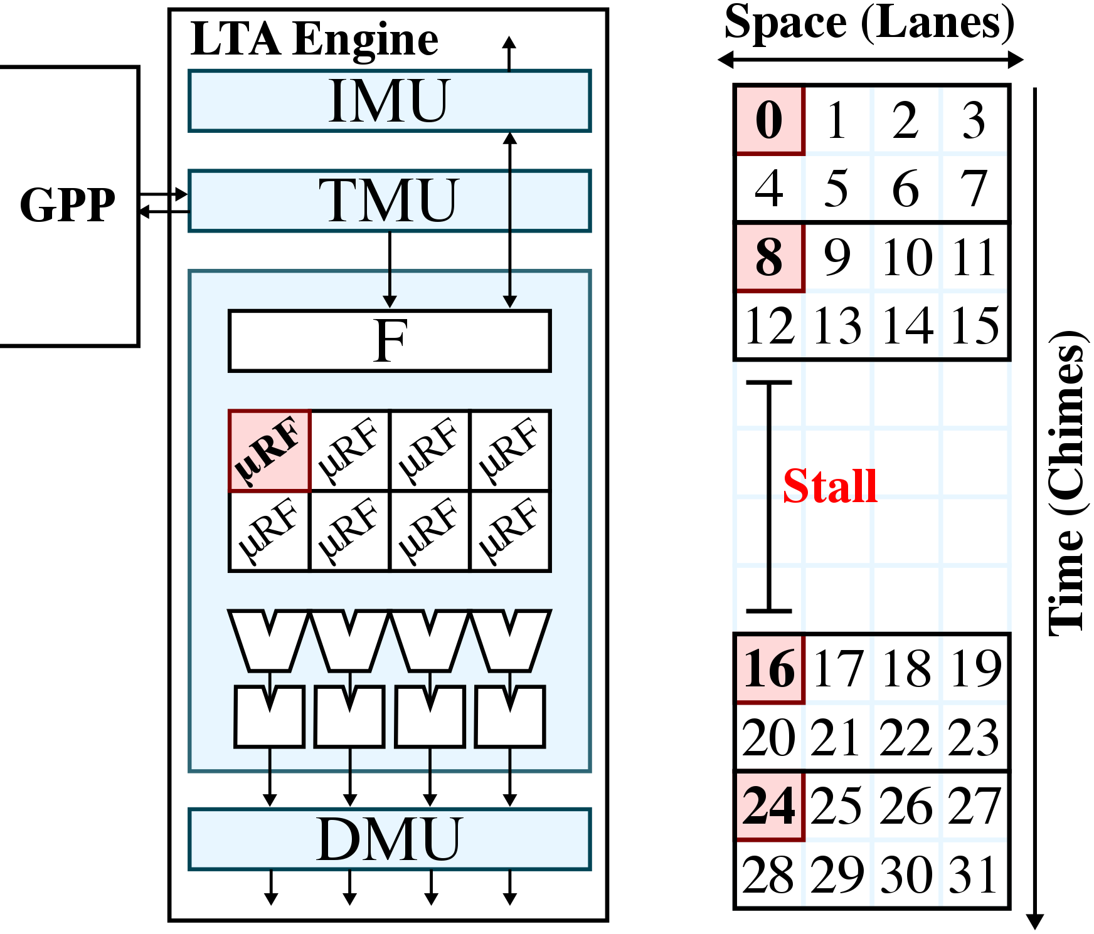
Tightly Coupled LTA Engine
Notes:
This is a simplified microarchitectural diagram of an example LTA engine.
The task management unit (TMU) serves as the primary interface between the GPP and the LTA engine, and is responsible for partitioning core tasks into utasks and mapping these utasks to uthreads.
Each uthread has its own register file context. And as you can see here, this particular LTA engine has 8 uthreads.
In addition, this LTA engine has 4 lanes, each with its own set of short-latency and long-latency functional units, and 2 chimes which is the number of uthreads that share the same lane.
uthreads can be tightly or loosely coupled in space and/or time, where uthreads that are tightly coupled must execute together in lock-step. In this example, all 8 uthreads are tightly coupled in both space and time.
As such, all uthreads here share a common frontend shown here, and instruction and data memory accesses are respectively managed by the IMU and DMU.
Here is an example execution diagram of how uthreads execute utasks in this LTA engine.
The x-axis is showing the lanes in space, and the y-axis is showing execution in time.
Each box here in a group corresponds to the uthread over here on the uarch diagram (the first uthread is highlighted in red).
Notice how the tightly coupled uthreads execute in lock-step in both space in time. Tightly coupled execution allows amortization of instruction/data memory accesses across multiple uthreads. For example, each instruction fetched keeps the uthreads busy for multiple cycles, and memory accesses across uthreads can be coalesced into more efficient wide requests.
The tradeoff is that execution will stall for all uthreads even if one uthread experiences control or memory divergence.

Slide 21
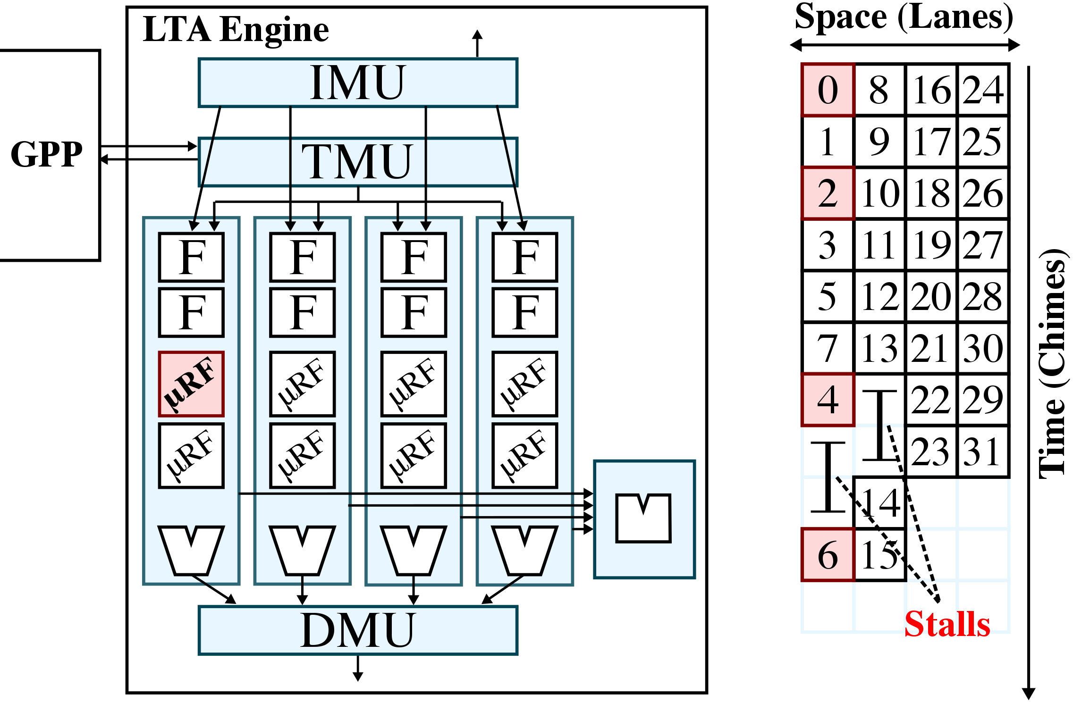
Loosely Coupled LTA Engine
Notes:
Now let’s take a look at a different 8-uthread LTA engine that is loosely coupled in both space and time.
The corresponding microarchitectural diagram is shown here. There are still 4 lanes, but now each lane is decoupled in space, with separate frontends that allow each lane to execute its own instruction stream.
There are still 2 chimes as well, but the 2 uthreads within a lane are also decoupled, so that they are also capable of executing their own instruction stream.
In addition, expensive resources such as the long-latency functional units and the data memory ports are shared across the lanes, requiring arbitration to access them.
If we look at the execution diagram for this LTA engine, we can see that the lanes on the right are capable of continuing execution even those these lanes on the left are stalled.
In addition, uthreads within a lane can be multiplexed to hide the stall of another uthread like shown here.
The tradeoff is that loosely coupled execution is that it cannot amortize memory accesses across more uthreads, and conflicts due to accessing shared resources can introduce other stalls.

Slide 22
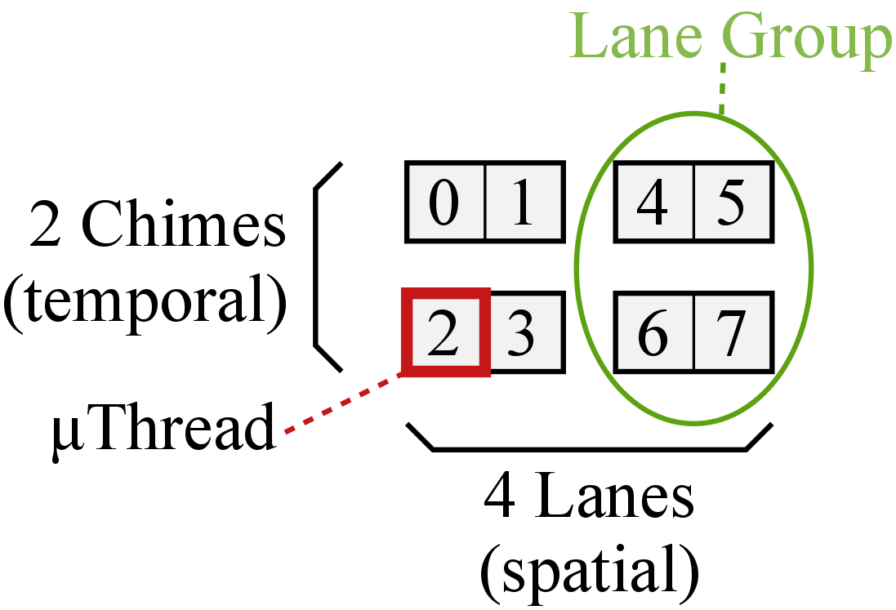
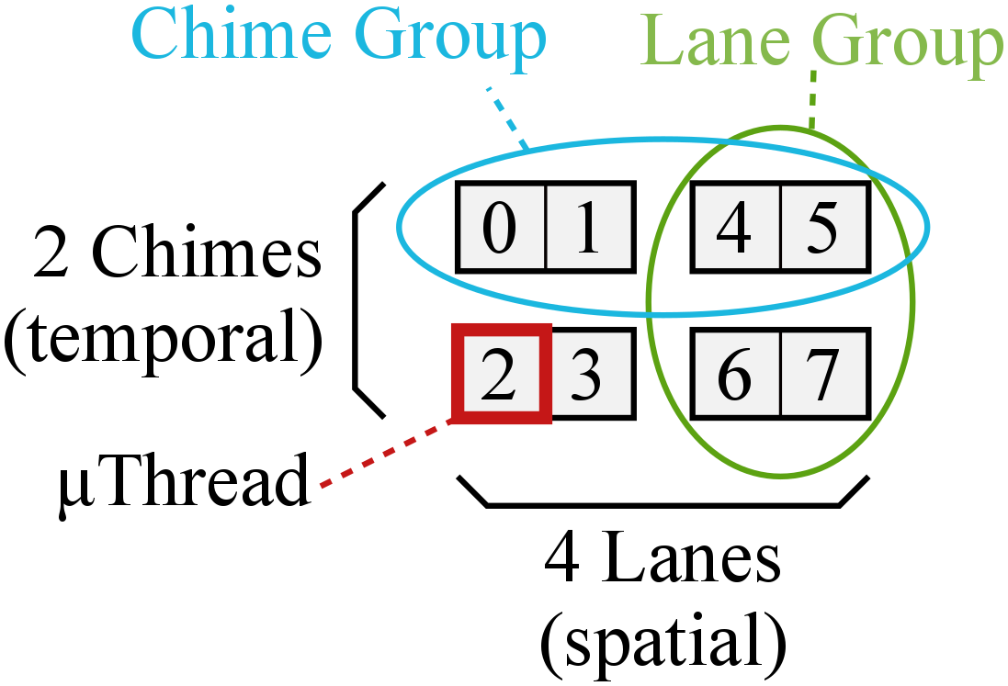
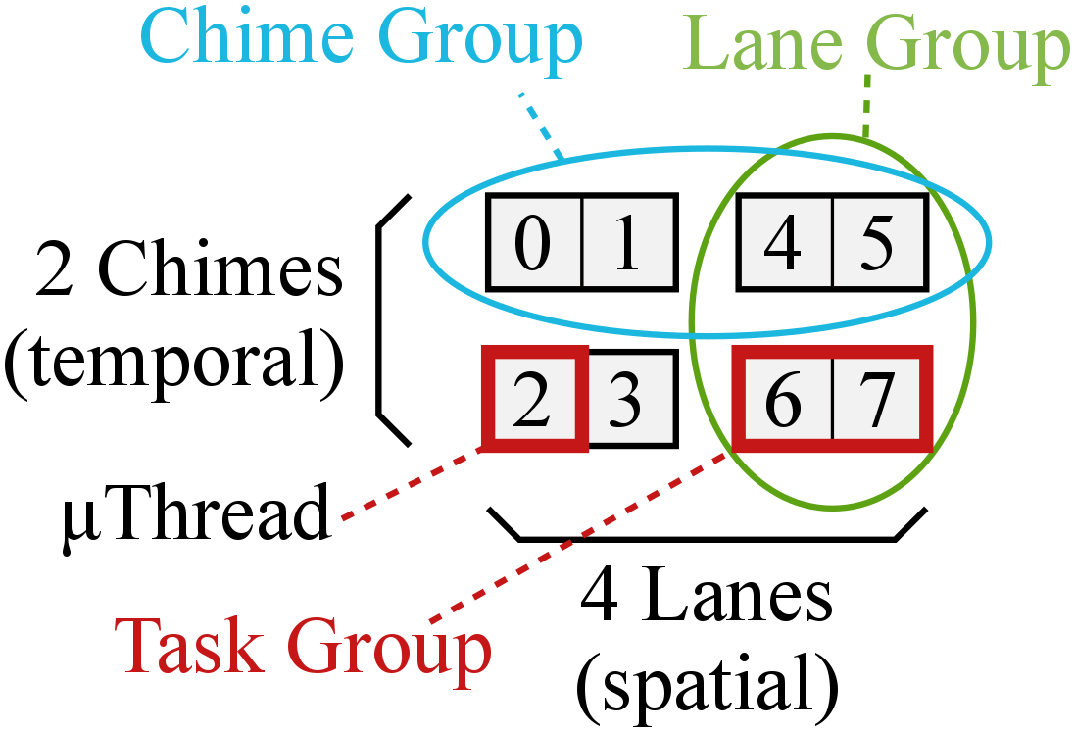
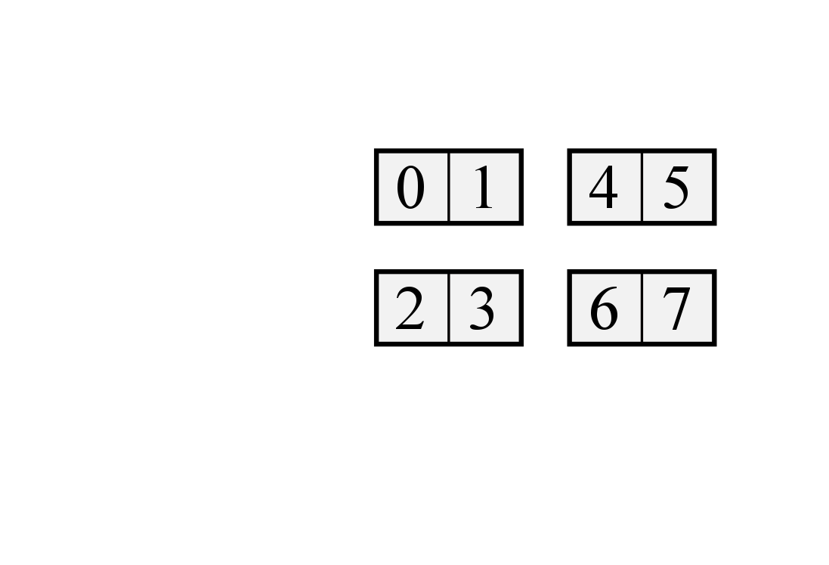
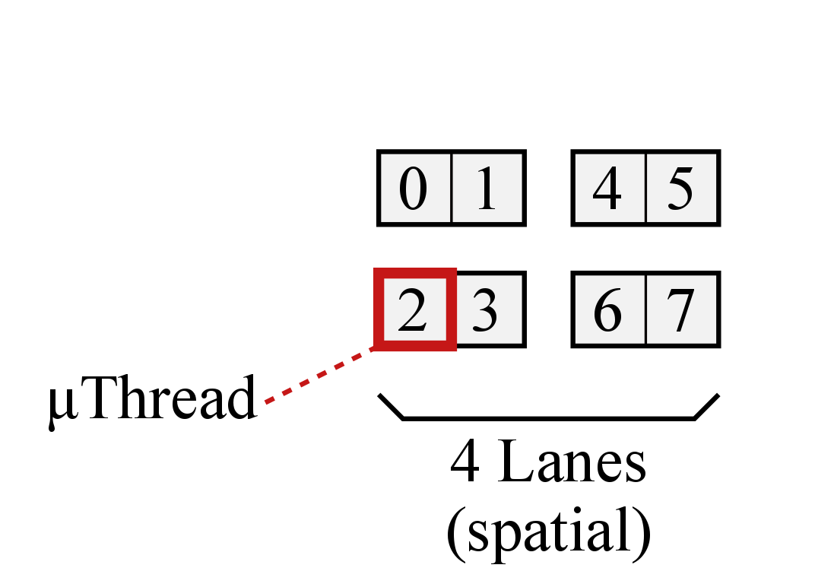
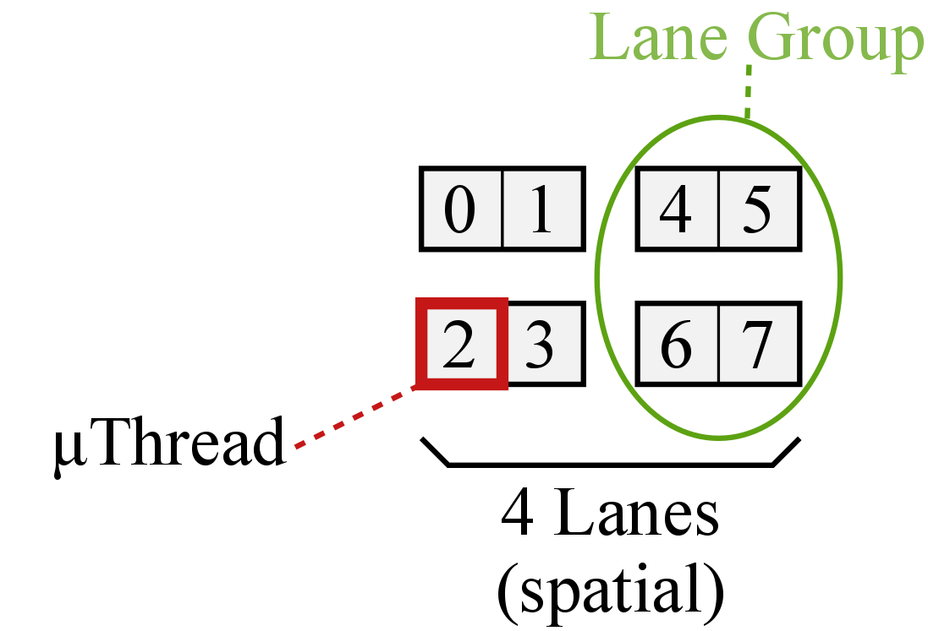
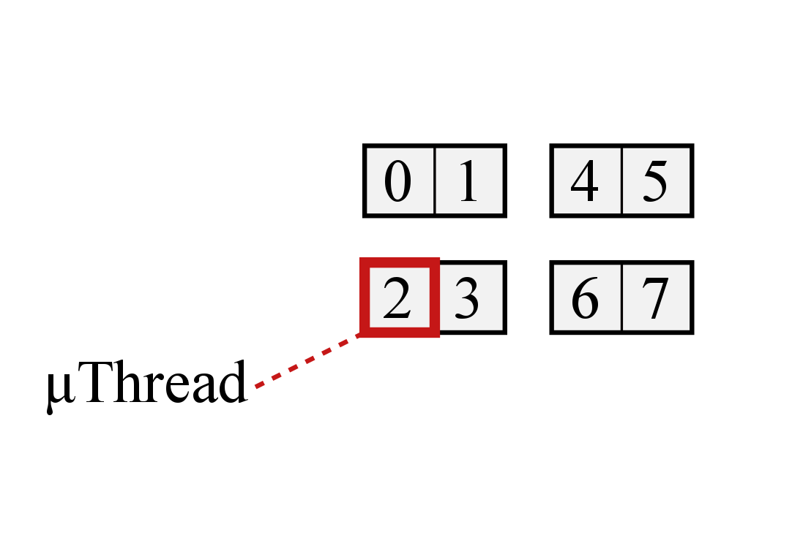
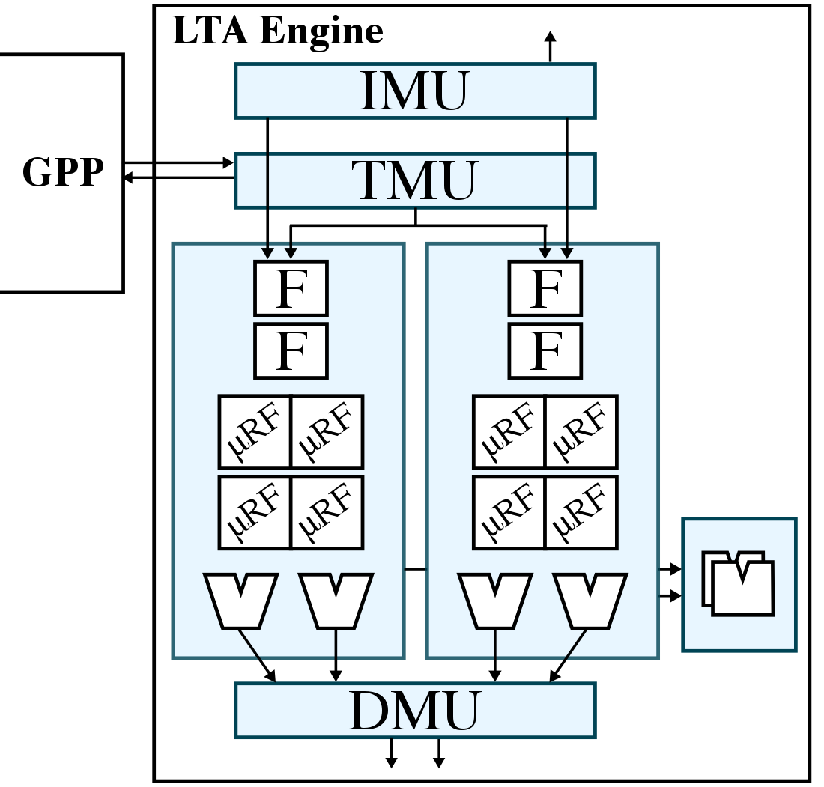
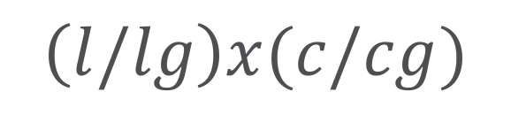
Task-Coupling Terminology
4/2x2/2
$$\left(l/lg\right)x(c/cg)$$
Notes:
The two examples that we just saw are the extreme ends of coupling in both space and time, but there is no reason why we can’t have a more moderate level of coupling as shown in this LTA engine.
Again, we still have 8 uthreads, but uthreads in space are grouped in sets of two, while the uthreads in time are still loosely coupled. You can imagine the opposite where uthreads in time are tightly coupled, but uthreads in space are loosely coupled as well.
As you can see, there is a spectrum of how uthreads, or the utasks that are mapped to uthreads, can be coupled in both space and time.
In order to succinctly capture this spectrum of what I would like to call “task coupling”, let’s define some useful terminology.
This picture on the right is an abstract representing of how uthreads are coupled in this particular LTA engine.
Each box represents a uthread, and we can see there are a total of 4 lanes in space which are grouped into 2 sets of 2 uthreads. Let us call each tightly coupled set of uthreads in space, lane groups.
And let us further denote the number of lanes and lane groups as the following...
In addition, we can see there are a total of 2 chimes in space, which are grouped into 2 sets of 1 uthread each. Let us call each tightly coupled set of uthreads in time, chime groups.
Similarly, we can denote the number of chimes and chime groups as the following...
More generically, each group of tightly coupled uthreads in either space or time can be called task groups, so there are 4 task groups in this LTA engine, with 2 lane groups and 2 chime groups.
This notation describes an LTA engine with any number of total uthreads, lanes, lane groups, chimes, and chime groups.

Slide 23
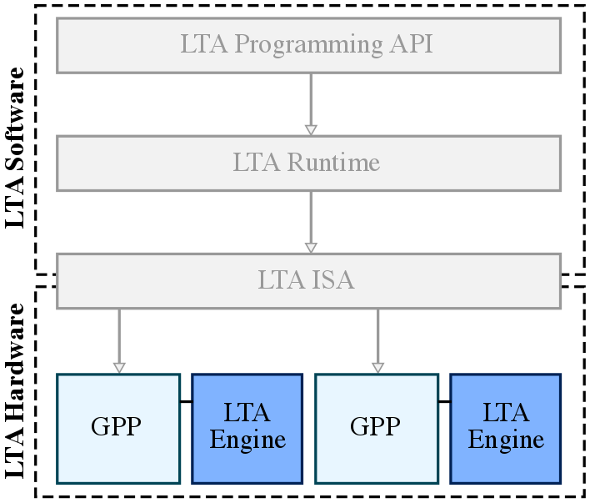
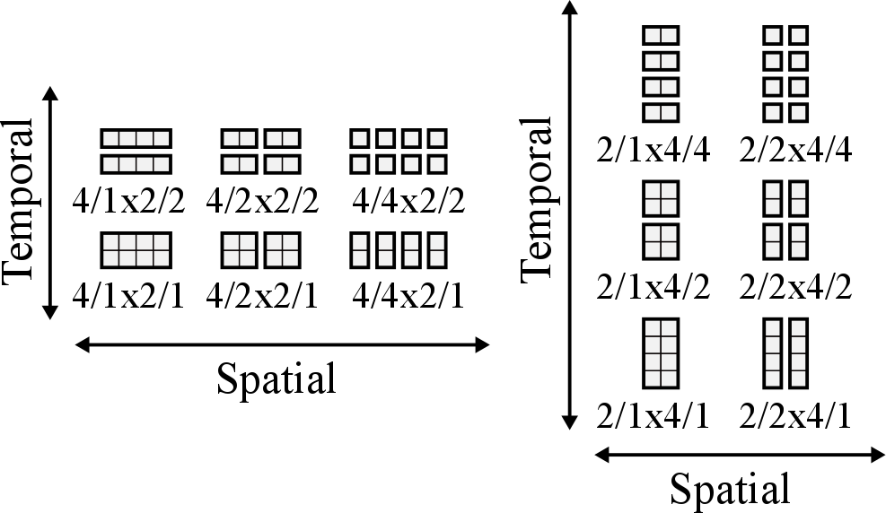
Task-Coupling Taxonomy
Notes:
Now we can take a look at the task coupling taxonomy that describes the spectrum of spatial and temporal task coupling for an 8-uthread LTA engine with 4 lanes.
These three configurations are what I just showed you, but there are other configurations as well.
We can extend this taxonomy to an 8-uthread LTA engine with 2 lanes, like shown here.

Slide 24
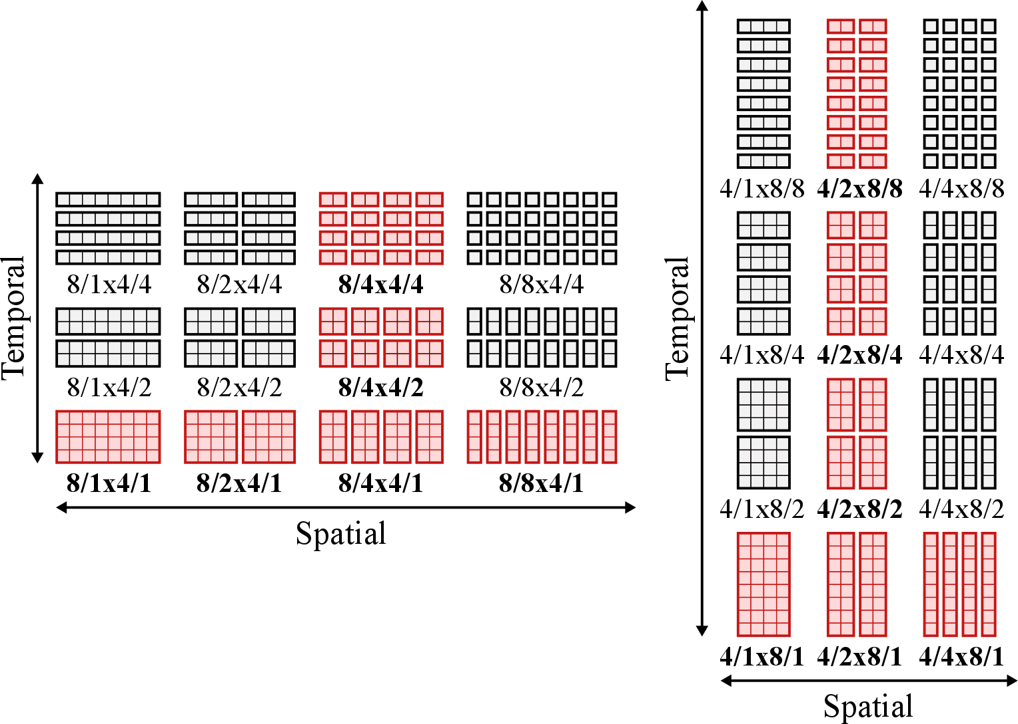
Task-Coupling Taxonomy
Notes:
And there’s no reason we can’t extend this taxonomy to a 32-uthread LTA engine with 8-lanes and 4-lanes either!
For the rest of the presentation, I will be focusing on the 32-uthread LTA engines with variable spatial and temporal task coupling highlighted in red here.

Slide 25
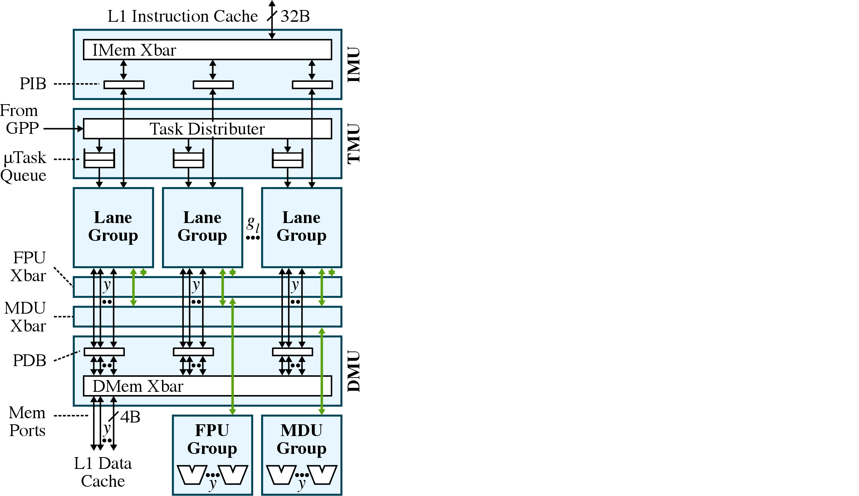
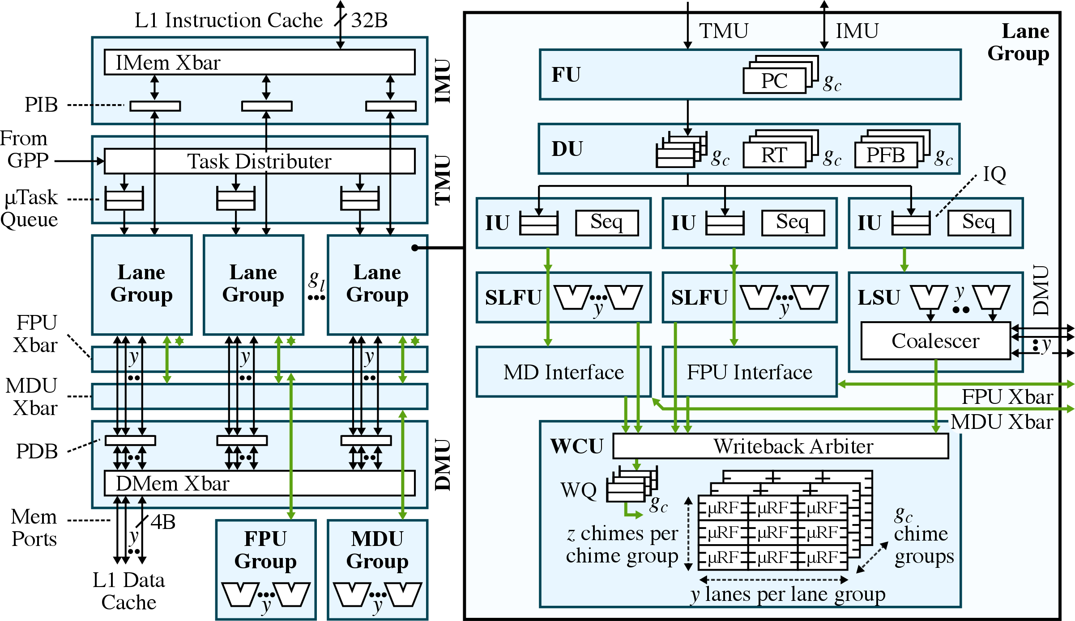
LTA Engine Template
Notes:
In order to explore this vast spectrum of task coupling, I developed an elegant LTA engine microarchitectural template that can be configured at design-time to have any number of uthreads and any degree of spatial and temporal task coupling.
This is a detailed uarch diagram for the LTA engine template. Let’s look at an example execution of an instruction in an LTA engine using this template…
In general, the amount of spatial task coupling can be configured by changing the number of lane groups, and the amount of temporal task coupling can be configured by changing the number of chime groups that can be multiplexed within a lane group.
The resources shared across the lane groups are the instruction fetch port managed by the IMU, the data memory port managed by the DMU, and the LLFUs composed of the FPUs and the MDUs.

Slide 26
Presentation Overview
App Dev Case Study
LTA Software
LTA Hardware
LTA Evaluation
Related Works
Conclusions

Slide 27
LTA Methodology
Ported 16 application kernels from PBBS and in-house benchmark suites with diverse loop-task parallelism
Scientific computing
N-body simulation, MRI-Q, SGEMM
Image processing
bilateral filter, RGB-to-CMYK, discrete cosine transform
Graph algorithms
breadth-first search, maximal matching, maximal independent set
Search/Sort algorithms
Radix sort, substring matching, dictionary

Slide 28
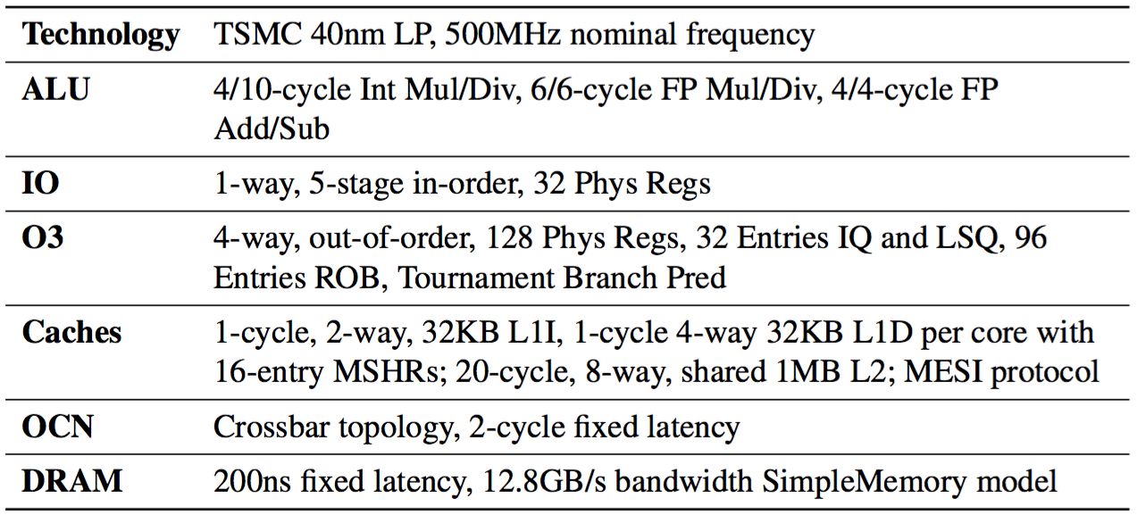
LTA Methodology
gem5 + PyMTL co-simulation for cycle-level performance
Component/event-based area/energy modeling
Uses area/energy dictionary backed by VLSI results
FG-SIMT RTL for lane groups
XLOOPS RTL for TMU and shared resources

Slide 29
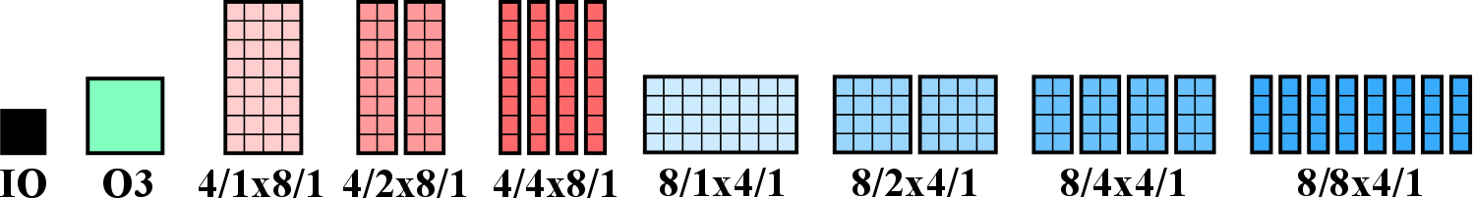
LTA Engine: Spatial Task Coupling: Performance
Notes:
Overall, performance from 4—5X vs. IO and 2—2.5X vs. O3.
Tighter coupling (less lane groups) improves perf on regular with high LLFU density. 27->19% on nbody, 26->17% on bilateral, 19->12% on mriq.
rgb2cmyk regular but no LLFUs. sgemm impacted by more stalls due to D$ misses. 26->52% on sgemm.
Looser coupling (more lane groups) improves perf on irregular with spatial control divergence. 11->18 rdups, 11->20 sarray, 6->10 strsearch, 10->16 bfs-d. Offset by increased conflicts in I$, but not noticeable until later.

Slide 30
LTA Engine: Spatial Task Coupling: Area
Notes:
Performance increases by factor of 4—6X, area increases by factor of 2—3X, so area efficiency is 2X.
Primary savings in sharing LLFUs and smaller D$ crossbar network.

Slide 31
LTA Engine: Spatial Task Coupling: Energy
tighter coupling
looser coupling
tighter coupling
Notes:
1.2—1.5X energy efficiency
Energy savings are mostly due to amortizing the frontend (I$ accesses and FU/DU/IU), more apparent on regular. Even irregular can benefit from cheaper PIB accesses.
D$ accesses with coalescing helps but offset by bigger crossbar network.

Slide 33
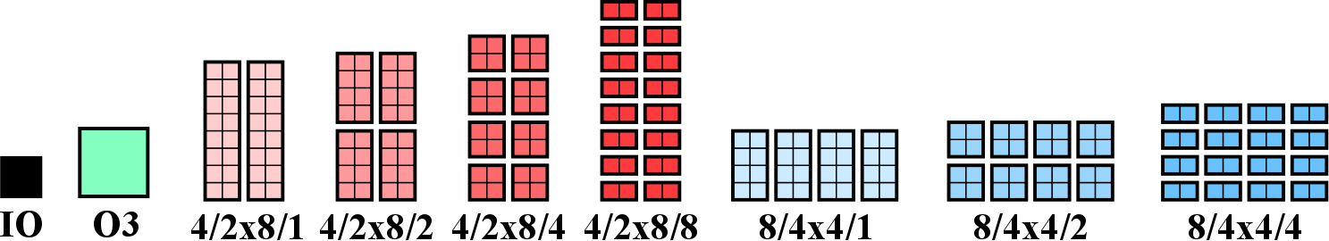
LTA Engine: Temporal Task Coupling: Performance
Notes:
Moderate coupling improves perf on regular/irregular.
Overall, loose temporal task coupling (more chime groups) marginal or worse performance. Due to I$ bottleneck with more task groups, 7->37% I$ stalls on rgb2cmyk.
On regular, reduced stalls due to D$ misses 10->4% on bilateral, 20->11% on mriq, 26->9% on sgemm.
On irregular, more chime groups does help hide microarchitectural latencies. 38->13% RAW stalls of strsearch.
Case studies: increasing uthread count better balance between number of chime groups and size of each chime group, and emulating more misses in L2 cache showed loose coupling much better at hiding D$ latencies.

Slide 35
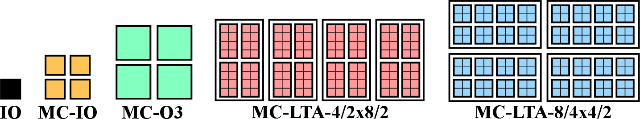
LTA Platform: Performance
area-normalized perf:
2.5X vs. MC-IO
1.7X vs. MC-O3
single-core LTA: 4.2—5.3X
multi-core IO: 3.1X
multi-core LTA: 13—16X
5.5X
3.0X
Notes:
4.2—5.3X speedup on intra-core, 3.1X speedup on inter-core (MC-IO): multiplicative speedup of 13—16X
vs. MC-IO: 5.5X raw perf, 2.5X area-norm perf, 1.2X eeff
vs. MC-O3: 3.0X raw perf, 1.7X area-norm perf, 2.5X eeff

Slide 36
LTA Platform: Productivity/Portability
CMP-AVX: memory alignment, eliminate control flow?
LTA: support for unaligned coalescing, divergence within task group
CMP-TBB: optimal grain size for load balancing?
LTA: LTA-aware task partitioning in runtime
CMP-TBB-AVX: disjoint inter- vs. intra-core abstractions?
LTA: loop task as common abstraction in SW and HW
MIC/GPGPU: re-tuning even with same SW framework?
LTA: same implementation can be used on GPP or LTA engine
MIC/GPGPU: struggles with irregular applications?
LTA: achieves multiplicative effects for both regular/irregular apps

Slide 37
Presentation Overview
App Dev Case Study
LTA Software
LTA Hardware
LTA Evaluation
Related Works
Conclusions

Slide 38
Related Works
Virtual ISAs
e.g.) AMD HSA, OpenCL, C++ AMP
DSLs
e.g.) Halide, OptiML, Delite
Work-stealing runtimes
e.g.) Cilk++, TBB
Libraries for productivity
e.g.) Thrust for CUDA
Accelerators for regular loop-task parallelism
e.g.) MICs, GPGPUs, FG-SIMT, Tarantula (vector-SIMD)
Accelerators for irregular (hybrid) loop-task parallelism
e.g.) XLOOPS, temporal SIMT (Echelon), variable warp size GPGPUs
GPGPU techniques
e.g.) dynamic warp subdivision/formation, static reconvergence

Slide 39
Previous Publications
J. Kim, C. Torng, S. Srinath, D. Lockhart, C. Batten. Microarchitectural Mechanisms to Exploit Value Structure in SIMT Architectures. ISCA 2013.
Fine-grain SIMT, tighter GPP integration, smaller vector length
J. Kim, C. Batten. Accelerating Irregular Algorithms on GPGPUs Using Fine-Grain Hardware Worklists. MICRO 2014.
Early experiments pushing SW abstractions to HW, inter- vs. intra- work distribution
J. Kim, S. Srinath, C. Torng, B. Ilbeyi, M. Wang, K. Al-Hawaj, S. Jiang C. Batten. Software/Hardware Co-Design to Improve Productivity, Portability, and Performance of Loop-Task Parallel Applications. Submitted to ASPLOS 2017.

Slide 40
Presentation Overview
App Dev Case Study
LTA Software
LTA Hardware
LTA Evaluation
Related Works
Conclusions

Slide 41
Contributions
Detailed analysis of 3P challenges in application development flow based on years of experience
LTA task-based work-stealing runtime and a new xpfor instruction for encoding loop tasks
LTA engine template with configurable spatial and temporal task coupling to accelerate loop tasks
Deep design-space exploration of task coupling and a 3P evaluation of the LTA platform

Slide 42
Avenues for Future Work
Generalizing to more forms of task parallelism
e.g.) recursion, nested parallelism
Heterogeneous LTA engines on multi-core system
Adaptive work scheduling using heuristics
Increasing energy efficiency with loose task coupling
Inter-lane-group memory coalescing
Extend PIB into shared L0 I$

Slide 43
Acknowledgements
BRG Members
Current: Shreesha, Chris, Berkin, Moyang, Shunning, Khalid
Previous: Derek, Jason Setter, Wei Geng, Scott McKenzie, Alvin Wijaya
CSL Members
Graduate Committee
Prof. Christopher Batten, Prof. Jose Martinez, Prof. Rajit Manohar
External collaborators
Prof. Martin Burtscher, Prof. Rupesh Nasre, Sripathi Pai
Prof. David Bindel
Funding
NDSEG Fellowship, NSF, AFOSR
Intel Corp., NVIDIA Corp., Synopsys Inc.

Slide 44
The End
Application development flow
LTA runtime + xpfor
LTA engine with spatial/temporal task coupling
Design space exploration + 3P evaluation of LTA platform

Slide 45
Presentation Overview
App Dev Case Study
LTA Software
LTA Hardware
LTA Evaluation
Related Works
Conclusions

Slide 46
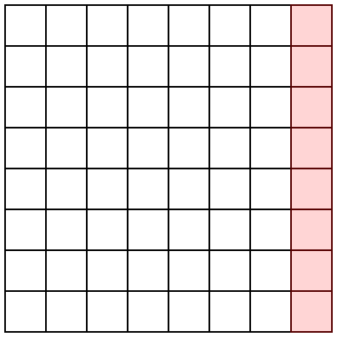

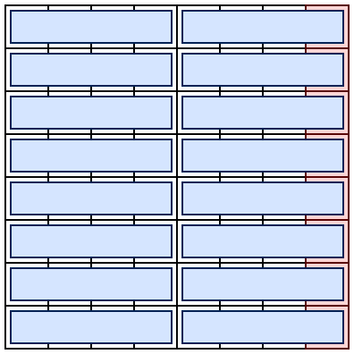
Matrix Alignment for Auto-Vectorization

Slide 47
LTA Programming API
void lta_function(
void* a, int start, int end, int step=1) {
args_t* args = static_cast<args_t*>(a);
int* dst = args->dst;
int* src0 = args->src0;
int* src1 = args->src1;
for (int i = start; i < end; i += step) {
if (src[i].cond0)
dst[i] = task0();
else if (src[i].cond1)
dst[i] = task1();
}
}
lta::parallel_for(0, size, [&](int i) {
if (src[i].cond0)
dst[i] = task0();
else if (src[i].cond1)
dst[i] = task1();
});
range step value
Notes:
Now let’s look at how these loop-tasks are exposed in the LTA programming API.
The lambda-based parallel_for was also explored, but unfortunately our cross-compiler does not support C++11 lambdas yet, so in this work I focus on the macro-based variant.

Slide 48




LTA Runtime
Notes:
Now that we know what utasks and uthreads are at a high-level, I would like to revisit the LTA runtime to identify how the utasks can interact negatively with the default task partioning algorithm.
In this example, I am showing a simplified version of a root task being partitioned into core tasks. The actual ranges of the tasks are not as important as the sizes of the tasks in the point I’m trying to illustrate here.
In the default partitioning scheme… we end up with 16 core tasks of various sizes. Now, let’s assume that we have 4 cores, each with 4 uthreads. Without going into too much detail for now, let’s further assume that these 4 uthreads must execute a task group in lock-step, such that the execution time of a core task of size 4 is roughly the same as that of a core task of size 1. In this scenario, an example execution might look like this, where each box is an equal unit of time and each column is a different core.
Remember that tasks are partitioned until the range size is less than equal to the core task size. In this example, the core task size is 4.
Notice that this is actually a bit inefficient and we’re leaving uthreads idle for entire blocks, since all utasks must be completed before the uthreads can be assigned a new set of utasks.
We can address this with an LTA-aware task partitioning scheme that dynamically reads the uthread count per core and partitions tasks so the range is a multiple of the uthread count. Here is an example of this scheme. Note that 20 -> 8/12, by dividing by half (10) and rounding to the nearest multiple of 4. In this case we end up with 11 core tasks… These core tasks are then executed on the same system like this.
Again this is assuming there isn’t too much variability in the amount of work across core tasks, and we’re making some simplifications, but it serves to get the main point across, which is that an LTA-aware task partitioning scheme can improve performance by compacting task groups into multiples of the uthread count (increasing hardware utilization).

Slide 49







Task Group Execution
Notes:
Ideally we would like an LTA engine that can accelerate regular and/or irregular applications. The key observation that I used to design the LTA engine is that task coupling in both space and time affect the performance, area, and energy efficiency of regular/irregular applications.
To see these impacts, I would like to look at an example of how an LTA engine with 8 uthreads executes a task group. As mentioned before, task groups are groups of utasks that need to executed in lock-step in both space and time. This LTA engine has 4 lanes which means that there are 2 chimes. Each instruction corresponds to all 8 uthreads and only needs to be fetched once. Half of the uthreads execute the instruction in the first chime, followed by the other half in the second chime…

Slide 50


Varying Spatial Task Coupling

Slide 51


Varying Temporal Task Coupling

Slide 52

Task-Coupling Terminology

Slide 53

Types of Control Divergence

Slide 54
LTA Runtime Validation
Experiments on Linux servers with Intel Xeon E5-2620 v3
x86 port of LTA runtime is competitive with Cilk++/TBB

Slide 55
LTA Engine: Spatial Task Coupling: Performance
Notes:
Overall, performance from 4—5X vs. IO and 2—2.5X vs. O3.
Tighter coupling (less lane groups) improves perf on regular with high LLFU density. 27->19% on nbody, 26->17% on bilateral, 19->12% on mriq.
rgb2cmyk regular but no LLFUs. sgemm impacted by more stalls due to D$ misses. 26->52% on sgemm.
Looser coupling (more lane groups) improves perf on irregular with spatial control divergence. 11->18 rdups, 11->20 sarray, 6->10 strsearch, 10->16 bfs-d. Offset by increased conflicts in I$, but not noticeable until later.

Slide 56
LTA Engine: Spatial Task Coupling: Area
Notes:
Performance increases by factor of 4—6X, area increases by factor of 2—3X, so area efficiency is 2X.
Primary savings in sharing LLFUs and smaller D$ crossbar network.

Slide 57
LTA Engine: Spatial Task Coupling: Energy
Notes:
1.2—1.5X energy efficiency
Energy savings are mostly due to amortizing the frontend (I$ accesses and FU/DU/IU), more apparent on regular. Even irregular can benefit from cheaper PIB accesses.
D$ accesses with coalescing helps but offset by bigger crossbar network.

Slide 58
LTA Engine: Temporal Task Coupling: Energy

Slide 59
LTA Engine: Temporal Task Coupling: Performance
Notes:
Overall, performance from 4—5X vs. IO and 2—2.5X vs. O3.
Tighter coupling (less lane groups) improves perf on regular with high LLFU density. 27->19% on nbody, 26->17% on bilateral, 19->12% on mriq.
rgb2cmyk regular but no LLFUs. sgemm impacted by more stalls due to D$ misses. 26->52% on sgemm.
Looser coupling (more lane groups) improves perf on irregular with spatial control divergence. 11->18 rdups, 11->20 sarray, 6->10 strsearch, 10->16 bfs-d. Offset by increased conflicts in I$, but not noticeable until later.

Slide 60

Application Characteristics

Slide 61

Application Statistics

Slide 63
Impact of LLFU Sharing with Temporal Task Coupling

Slide 64
Impact of uthread Count on Temporal Task Coupling

